Slide 1
SUBTITLE
October 20 – 21, 2016
Omni Houston Hotel at Westside
Houston, Texas

Slide 2
STUCK IN THE GRADES VS. DASHBOARDS WAR?
You’re in the right place.

Slide 3
Opponents of School Ratings are pretending there are only two choices

Slide 4
And at least a few states give you a glimpse of what that can look like.
There is ….

Slide 5
New York Dashboard

Slide 6
NY Dashboard Continued

Slide 7
NY Continued

Slide 8
NY Continued

Slide 9
Lots of data, most of it unexplained (and unevaluated), no context.
And no reason for anybody to feel any urgency about anything.

Slide 10
Then there is…

Slide 11
Oklahoma

Slide 12
Looks like fair amount of data, but turns out that only thing that is comprehensible is the grade.
So, in this case, there may be urgency, but certainly no clarity on what might be going on.

Slide 13
So, if we don’t want a rating without dashboard-type data, or a dashboard that doesn’t clearly evaluate how well schools are serving every group of kids…

Slide 14
General idea: Something that combines both.
A summative Rating to create urgency wherever either students in general or any group of students isn’t doing well.
Plus a dashboard of relevant (and disaggregated) information on what went into the rating and other important domains.

Slide 15
Certainly, parents are clear that they want grades.

Slide 19
And, while there is still some fighting about it, both the law itself and the Department of Education’s proposed regulations would appear to require a summative rating.
(After all, if Congress didn’t intend a summative rating, why did they spend so many months arguing about how much indicators should weigh?)

Slide 20
But just as some states did with NCLB, recalcitrant states could probably get away with a non-evaluative dashboard that included a simple notation of whether the school was a “priority” or “targeted assistance” school.

Slide 21
So, as advocates, you’re going to need to get clearer on what you think is essential.
Let’s take a look at a few state systems, existing or proposed…

Slide 22
Keep three questions in mind:
Is the approach understandable to a range of audiences?
Will it communicate real urgency--both around overall low performance AND underperformance of any group—and clearly signal when action is necessary?
Does it clearly prioritize student outcomes, including achievement, graduation and progress toward English proficiency for English Learners?

Slide 23
Illinois…

Slide 24
(Illinois, continued)

Slide 25
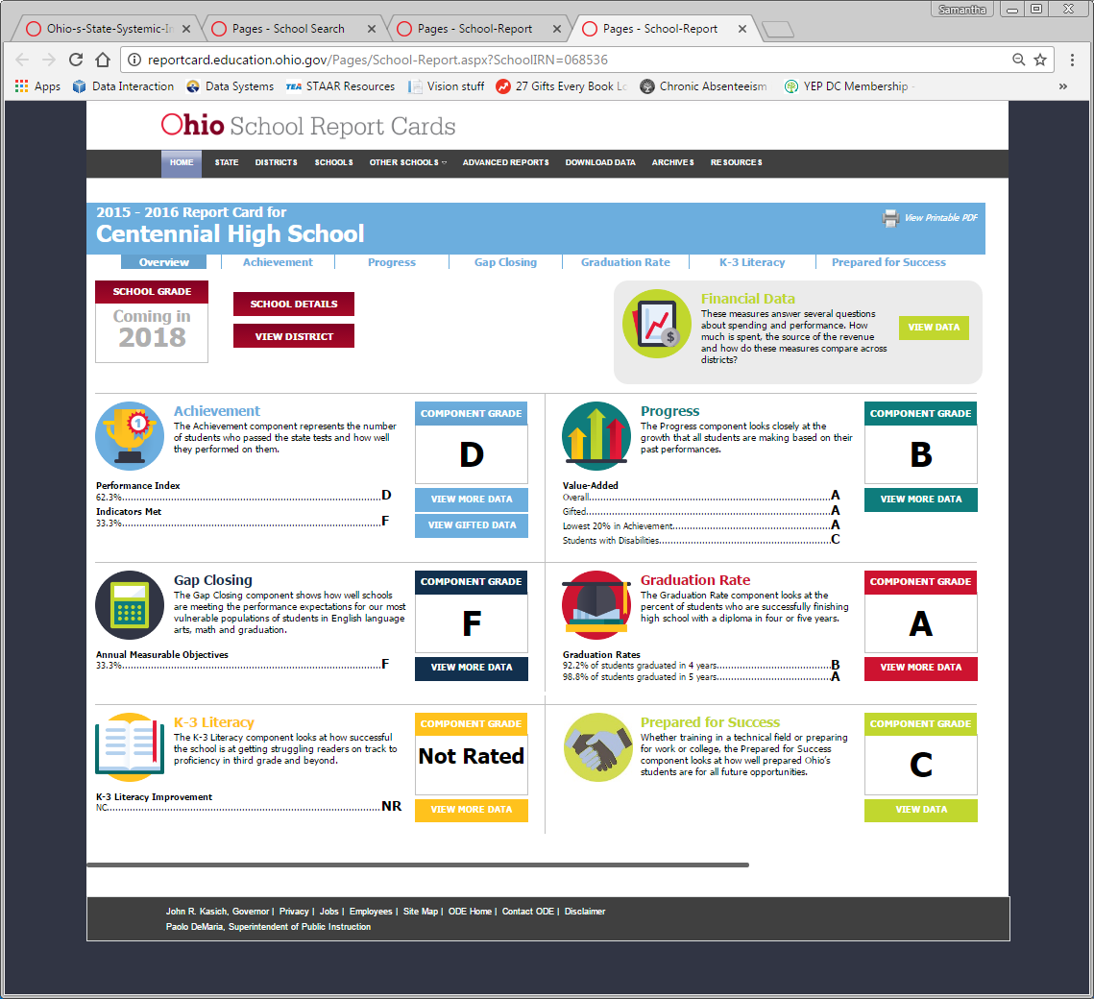
Ohio

Slide 26
Michigan

Slide 30
CA – Option ONE

Slide 31
CA – Option Two

Slide 32
There is no one right answer. But again, by keeping these questions front and center, you should be able to press for something that works.
Is the approach understandable to a range of audiences?
Will it communicate real urgency--both around overall low performance AND underperformance of any group--and clearly signal when action is needed?
Does it clearly prioritize student outcomes, including achievement, graduation and progress toward English proficiency for English Learners?

