Slide 1
SUBTITLE
October 20 – 21, 2016
Omni Houston Hotel at Westside
Houston, Texas

Slide 2
School ratings can be a powerful tool for equity
By defining what it means to get an “Excellent” or a “Good” rating, rating criteria can make clear that to be considered a high-performing school, a school has to be serving all of its students – not just some – well.
By identifying schools that are not meeting expectations for one or more groups of students, ratings can prompt action and help districts and states better target resources and supports.
Excellent
Good
Acceptable
Needs Improvement
Struggling

Slide 3
But the way rating criteria are designed can make the difference between illuminating educational disparities… or hiding them.

Slide 4
Goals of session
Talk through key decisions states have to make if they are either creating a new accountability system, or making really big changes from their existing one.
Identify questions to ask about these decisions in your state; and
Highlight potential ways – good and bad – that states could approach making those decisions.

Slide 5
To be clear…
There are way more decisions that go into an accountability system than we’ll talk about. But we’ll try to highlight key points that are especially important for equity.
There multiple good ways to make each decision, and multiple bad ways. We’ll talk about some examples – but there’s no way we can be exhaustive.

Slide 6
So, what are those key decisions states will have to make?
How do we combine these measures into a rating?
What are we going to measure?
What are our expectations on each of these measures?
How do we include both performance and progress?
How much should different indicators weigh?
How do we include results for all groups of students?
How do we define “consistently underperforming”?

Slide 7
To help us walk through all of these decisions, let’s use an example school
Wilson Middle has 800 students in grades 6-8
Student demographics
Disclaimer: Wilson Middle is fictional. But it’s not atypical.

Slide 8
What are we going to measure?

Slide 9
The state where Wilson Middle is located has chosen to look at the following indicators**:
Achievement: Percent of students on grade level in reading, math and science
Adequate growth: Percent of students making sufficient progress to get to grade level, or stay at grade level in reading and math
Percent of ELs making progress toward English language proficiency: Note: Does not apply to this school (not enough English learners)
Additional indicator of school quality (1): Percent of 8th graders successfully completing Algebra 1 (passing end-of-course assessment)
Additional indicator of school quality (2): Percent of students suspended or expelled
** Note: Not a recommendation. We just needed to pick some metrics.

Slide 10
What are our expectations on each of the measures?

Slide 11
How is Wilson Middle doing on these indicators?
69%
Are on track to reach or stay at grade level by graduation.
69% of students
Met grade level standards in reading
72% of students
Met grade level standards in math
62% of students
Met grade level standards in science
76% of students
Made adequate growth in reading
64% of students
Made adequate growth in math
Are these results good? Acceptable? Bad?
42% of students
Took and passed Algebra
10% of students
Were suspended or expelled

Slide 12
Take reading, for example…
69% of students met grade level standards in reading at Wilson middle school.
If the state average is 50%... Would you think this was good or bad?
What if the state average was 90%?
Notes:
Charts to illustrate this

Slide 13
Now let’s make things more complicated…
Because behind each of these “school-wide averages” are vastly different results for each group of students.
Notes:
Bar charts

Slide 14
Oh, and remember that one year’s worth of data only tells us so much…
For example, results in reading at this school have been going up, both overall and by group.
In math, the trends are much more mixed.
Notes:
Line graphs

Slide 15
Having clear expectations for both performance and improvement is critical to making sense of all this information.

Slide 16
Key principles: Expectations
Schools should know what they are expected to do before the school year begins to reach a certain rating.
Expectations should be rigorous.
Expectations for performance should be the same for all groups of students.
Expectations for improvement should demand more gains for groups of students who are further behind.

Slide 17
Questions to ask about performance expectations

Slide 18
Do schools know how they are expected to perform before the school year begins to reach a certain rating?
Has the state set specific performance thresholds for each indicator? (see example)
Is that information available the summer before school starts?
Percent on grade level | Points awarded
80% or greater | 5 points
65 – 80% | 4 points
55 - 65% | 3 points
45 – 55% | 2 points
Less than 45% | 1 point
Things to watch out for:
The state doesn’t set expectations for each indicator. This makes it harder for schools to figure out what they need to do to get a particular rating.
The state bases ratings or points based on school rankings. This means that a school’s rating depends not just on how it performs, but on how other schools perform.

Slide 19
Are expectations rigorous?
What percent of schools earns each amount of points (or each rating) based on results for all students? How about each group of students?
i.e. If half of schools are reaching the top level of performance, the expectations are probably not high enough.

Slide 20
Are expectations for performance the same for all groups of students?
The state should have one set of performance thresholds that apply to all groups of students.
You want to see this:
And NOT this:
Student Group | Graduation rate needed to earn…
 | 5 points | 4 points | 3 points | 2 points | 1 point
All students | 95 % and over | 85-94 % | 75-84 % | 67-74 % | Below 67 %
Black | 95 % and over | 85-94 % | 75-84 % | 67-74 % | Below 67 %
Latino | 95 % and over | 85-94 % | 75-84 % | 67-74 % | Below 67 %
Native | 95 % and over | 85-94 % | 75-84 % | 67-74 % | Below 67 %
Asian | 95 % and over | 85-94 % | 75-84 % | 67-74 % | Below 67 %
White | 95 % and over | 85-94 % | 75-84 % | 67-74 % | Below 67 %
Low Income | 95 % and over | 85-94 % | 75-84 % | 67-74 % | Below 67 %
Students with Disabilities | 95 % and over | 85-94 % | 75-84 % | 67-74 % | Below 67 %
English learners | 95 % and over | 85-94 % | 75-84 % | 67-74 % | Below 67 %
Student Group | Graduation rate needed to earn…
 | 5 points | 4 points | 3 points | 2 points | 1 point
All students | 95 % and over | 86-94 % | 76-85 % | 67-75 % | Below 67 %
Black | 90 % and over | 84-89 % | 74-83% | 65-73 % | Below 65%
Latino | 87 % and over | 79-86 % | 72-78 % | 62-71 % | Below 62 %
Native | 85 % and over | 76-84 % | 67-75 % | 59-66 % | Below 59 %
Asian | 96 % and over | 89-95 % | 78-88 % | 69-77 % | Below 69 %
White | 97 % and over | 88-96% | 80-87 % | 71-79 % | Below 71 %
Low Income | 87 % and over | 79-86 % | 70-78 % | 62-69 % | Below 62 %
Students with Disabilities | 75% and over | 68-74 % | 59-67 % | 50-58 % | Below 50%
English learners | 77 % and over | 71-76 % | 62-70 % | 52-61 % | Below 52 %

Slide 21
Are expectations for performance the same for all groups of students?
Watch out for:
Attempts to compare results for a group of students with other schools’ results for the same group.
For example, calling a school “high performing” because its low-income graduation rates are in the top 10% of graduation rates for that group.
Or conversely, only calling a school low-performing for a group if it’s in the bottom 10% (or 20, or 30%) of the group’s results.

Slide 22
For our example, we’re setting the following thresholds, which apply to results for all students and each student group:
 | Percent Proficient- Reading | Percent Proficient - Math | Percent Proficient - Science | Adequate Growth - Reading | Adequate Growth - Math | Percent suspended or expelled | Percent earning High School Credit
5 Points | >71% | >70% | >75% | >68% | >64% | <2% | >53%
4 Points | 56%-71% | 54% - 70% | 61%-75% | 58%-68% | 45%-64% | 2%-8% | 44%-53%
3 Points | 47%-55% | 42%-53% | 50%-60% | 40%-57% | 37%-44% | 9%-13% | 32%-43%
2 Points | 33%-46% | 31-41% | 40-49% | 27%-39% | 24%-36% | 14%-21% | 19%-31%
1 Point | <33% | <31% | <40% | <27% | <24% | >21% | <19%
Notes:
Table with expectations

Slide 23
Here’s how Wilson is doing against these expectations

Slide 24
Expectations for improvement: Goals

Slide 25
What are accountability goals?
Goals communicate clear expectations for-- and build real urgency around--the kind of improvements necessary to get all children, rather than just some, on a trajectory to be ready for college and career.
Getting the goals right is critical. Goals should be both ambitious and attainable.
Goals that are too low won’t lead to meaningful change for students.
Goals that are so high as to feel completely out of reach will result in a lack of buy-in from educators, and are likely to be dismissed as unrealistic.

Slide 26
States could take different approaches for setting goals
They could pick a number that they think the public will find palatable.
They could set goals based on how top-performing schools are doing for all students today.
The threshold for getting top credit on each indicator could become the goal for that indicator.
Timelines matter a lot, too. Expecting schools to reach goals sooner makes a lower goal more ambitious. Giving schools more time to reach a goal makes a higher target for attainable.

Slide 27
Key questions to ask about goals:
Are the goals both ambitious and attainable?
Are the goals the same for all groups of students?
How will the state track progress toward goals?

Slide 28
Are the goals both ambitious and attainable?
Ask your state: If our schools were to continue to make gains similar to those they’ve made in recent years, how many would meet the goals for all students? For each group of students?
What to look for in the answer:
Less than half of schools should be able to meet goals for the all- student group.
For low-income students, students of color, English learners and students with disabilities, the numbers should be even smaller. Only the highest-achieving and fastest improving schools - perhaps between 10 and 20 percent -- should be able to meet the state’s proposed goals by simply continuing to do what they are currently doing.

Slide 29
Are goals the same for all groups of students?
To avoid sending the signal that states expect lower achievement for groups that start out further behind, states should set the same goal – e.g., the percent of students that must be on grade level -- for all schools and all groups of students.
If a state chooses to set different accountability goals state leaders must ensure and make absolutely clear that
The goals demand more progress for schools and groups of students that are further behind; and
Meeting these goals will place schools on a path to the same ultimate goal (such as a 100 percent on grade-level rate). If this is not clear those goals are unacceptable.

Slide 30
Examples of potential goal-setting approaches
Approach | Notes
Set goals based on how top-performing (e.g., top 10 percent) of schools are doing for students overall. Expect all schools to reach this level of achievement in 10 years for all groups of students. | This goal will require most schools to make substantial improvement, and to make bigger gains for groups of students that are further behind. The goal is the same for all schools and all student groups.
Expect all schools to get half-way to the ultimate goal (e.g., 100 percent on grade level) within 10 years. | While this approach will also require bigger gains for schools and student groups that are further behind, it can be misinterpreted as setting different expectations for different groups of students.
Set goals for each student group based on how top-performing schools are doing for that group now. Expect all schools to reach that level of achievement in 10 years. | This approach sets different expectations for each student group. Schools are only expected to do as well for each student group as top-performing schools are doing for that group right now.
Expect all schools to improve the percent of students on grade level by 2 points per year for all students and each student group. | This approach fails to require more progress for schools and groups that are further behind, and as a result, enables disparities in opportunity and achievement between groups of students to continue.

Slide 31
How will the state measure progress toward the goals?
States could set one benchmark that they expect all schools to reach for all groups of students each year.
This approach doesn’t recognize the fact that schools start out in very different places.
Low performing schools that make lots of progress won’t get credit.
High performing schools that don’t improve could still meet the annual target.
Figure 2: Setting a single annual progress target for all schools
Year | Progress Target (Percent on grade level)
2017 | 34 percent
2018 | 38 percent
2019 | 42 percent
2020 | 46 percent
2021 | 50 percent
2022 | 54 percent
2023 | 58 percent
2024 | 62 percent
2025 | 66 percent
2026 | 70 percent
Notes:
Align this example with our performance thresholds.

Slide 32
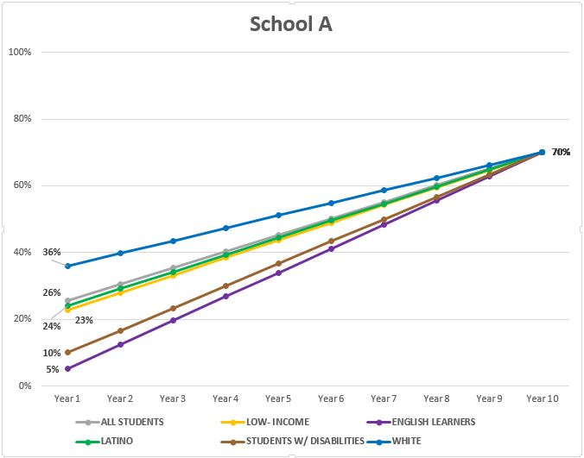
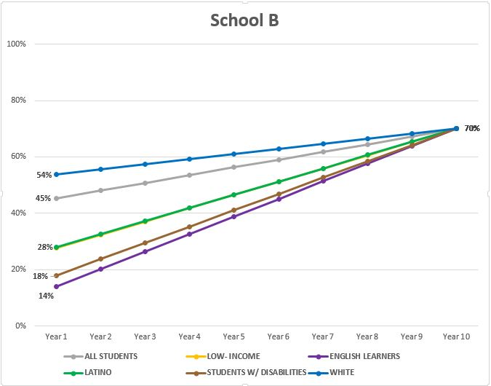
How will the state measure progress toward the goals? Continued.
States could set targets that take into account where each school is starting from for each student group and map a path toward reaching the state’s goal.
This approach is fairer to schools that start out lower performing, and it makes clear that higher performing schools also have to make progress.

Slide 33
Our example state us using the thresholds schools have to reach to earn the most points on each indicator as our goals.
 | Percent Proficient- Reading | Percent Proficient - Math | Percent Proficient - Science | Adequate Growth - Reading | Adequate Growth - Math | Percent suspended or expelled | Percent completing Algebra 1
Target | 71% | 70% | 75% | 68% | 64% | 2% | 53%
Timeframe | 10 years | 10 years | 10 years | 7 years | 7 years | 5 years | 7 years

Slide 34
And we’re going to track whether schools are on track to reach goals, based on the improvement they are making. Here’re Wilson’s results:

Slide 35
How do we combine these measures into a rating?

Slide 36
How do we combine performance and progress?

Slide 37
We now have two sets of information to work with: How Wilson is doing based on performance expectations, and whether the school is on track to meet improvement goals. How do we put that information together?

Slide 38
Note: Right now, few states include both performance and improvement in their rating. Some do look at individual student growth (in our case, the “percent making adequate growth” indicator). But most don’t look at improvement on other measures – like graduation rates.

Slide 39
Why both performance and progress matter
Performance
only
Doesn’t give schools credit for improving outcomes unless they hit certain performance benchmarks.
Both Performance and Progress:
Gives schools credit for improvement, but takes into account where their students are now, too.
Progress
only
May prioritize high-performing schools that are not making gains over schools that are low achieving and improving.

Slide 40
How could you include both performance and progress?

Slide 41
For each indicator and each group of students, you could do something like this:
Final score
Yes
Is school on track to meet goal?
School’s current results
Preliminary points based on current results
Final score
No

Slide 42
In our example, we give schools preliminary points based on how they are doing, then give them an extra point if they are on-track to meet goals.

Slide 43
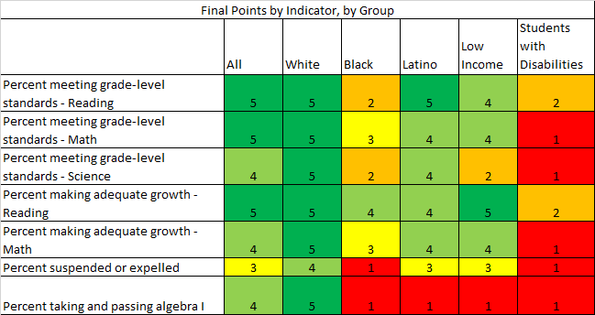
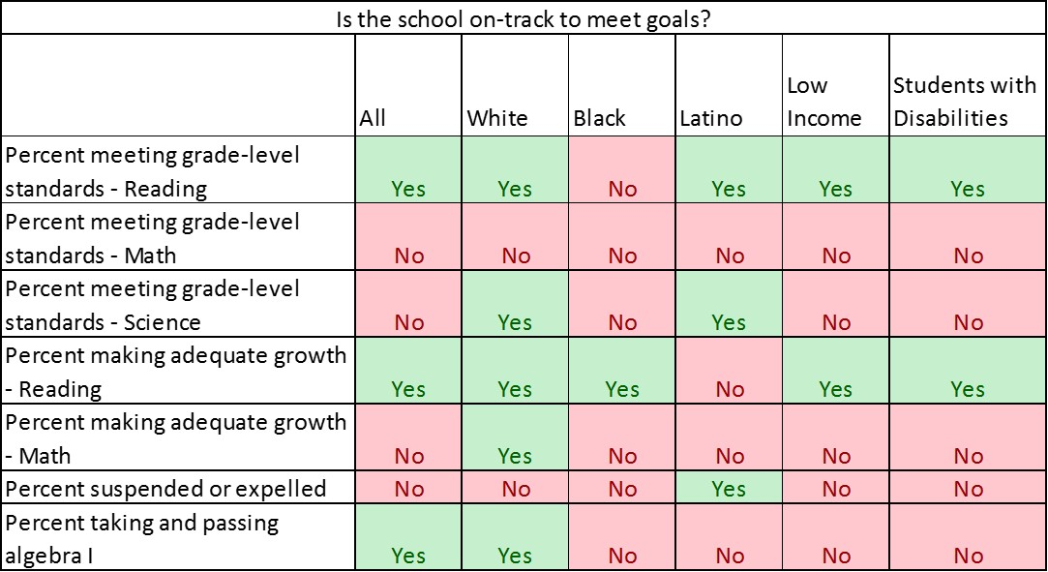
In other words…

Slide 44
Here is a summary of how Wilson does for each group of students on each of the indicators. Question: What rating (1-5) would you give this school?

Slide 45
How do we weigh different indicators?

Slide 46
ESSA Requirements
Academic achievement: A measure of how schools’ proficiency rates in reading/language arts and math for all students and each student group compare with state-set goals. For high schools, states can also include student growth as part of this indicator.
Graduation rates (high school) or Another Academic Indicator (non-high schools) For high schools, a measure of how graduation rates for all students and each student group compare with state-set goals. For elementary and middle schools, this measure may be individual student growth or another statewide, valid, and reliable indicator of student learning (such as science assessment results).
English-language proficiency: A measure of the progress that a school’s English learners are making toward English proficiency.
Additional indicator of school quality or student success: Another valid, reliable, and statewide indicator of school quality.
Each of these indicators has to carry substantial weight (i.e., count a lot). Together, these three indicators have to count for more than the additional indicator of school quality or student success.

Slide 47
The “right” weighting depends on the indicators in the mix.
Consider two states:
State A chooses to use participation and success in rigorous courses – like AP, IB and dual enrollment – as its additional school quality indicator.
State B chooses to measure the percent of students participating in one or more extracurricular activities.
Arguably, you’d want State A to give the school quality indicator more weight than State B.

Slide 48
The bottom line is: Rating criteria must make it clear that students’ academic success (including progress toward English-language proficiency for English learners) and graduation rates hold the most sway.

Slide 49
A school with continuously low achievement or graduation rates shouldn’t be excused from addressing that problem just because it has, for example, low chronic absenteeism rates.
On grade level in reading: 10%
On grade level in math: 12%
Percent ELs making progress toward English proficiency: 33%
Graduation rate: 68%
Chronic absenteeism rate: 1%
This school needs help

Slide 50
Here are the weights our example state assigned:
 | Percent of rating
Percent meeting grade-level standards - Reading | 20%
Percent meeting grade-level standards - Math | 20%
Percent meeting grade-level standards - Science | 10%
Percent making adequate growth - Reading | 15%
Percent making adequate growth - Math | 15%
Percent suspended or expelled | 10%
Percent taking and passing algebra I | 10%

Slide 51
How do we combine results across student groups?

Slide 52
As a reminder, here is our summary table for Wilson.

Slide 53
Right now, in most states, ratings are calculated primarily or entirely based on all-student averages.
Everything underneath this box does not count.

Slide 54
Obviously, that’s unacceptable. So how could a state do better?
There are different ways to make group results count.
One thing a state could do is give significant weight to the results of each student group when calculating ratings.
For example, the state could give equal weight to the results of each group of student – including the all-student group.

Slide 55
Example: Calculating Wilson’s science score.
Science score = (4+5+2+4+2+1)/6 = 3

Slide 56
If you do this for all of the indicators, then combine them, Wilson would get a 3.
3

Slide 57
But a state could go even further. In addition to calculating that 3, it could also report the total score for each group.

Slide 58
Shown another way…
Overall rating | How is our school doing for…
 | All students?
 | White students?
 | Black students?
 | Latino students?
 | Low income students?
 | Students with disabilities?

Slide 59
Another option: Calculate a preliminary grade based on all-student results…
But then lower that grade if a school is consistently underperforming for any student group.

Slide 60
How will we define “consistently underperforming”?

Slide 61
Under ESSA, if a school is consistently underperforming for a group of students, its rating needs to reflect that, and the school has to take action to improve.

Slide 62
How a state defines “consistent underperformance” is really important.

Slide 63
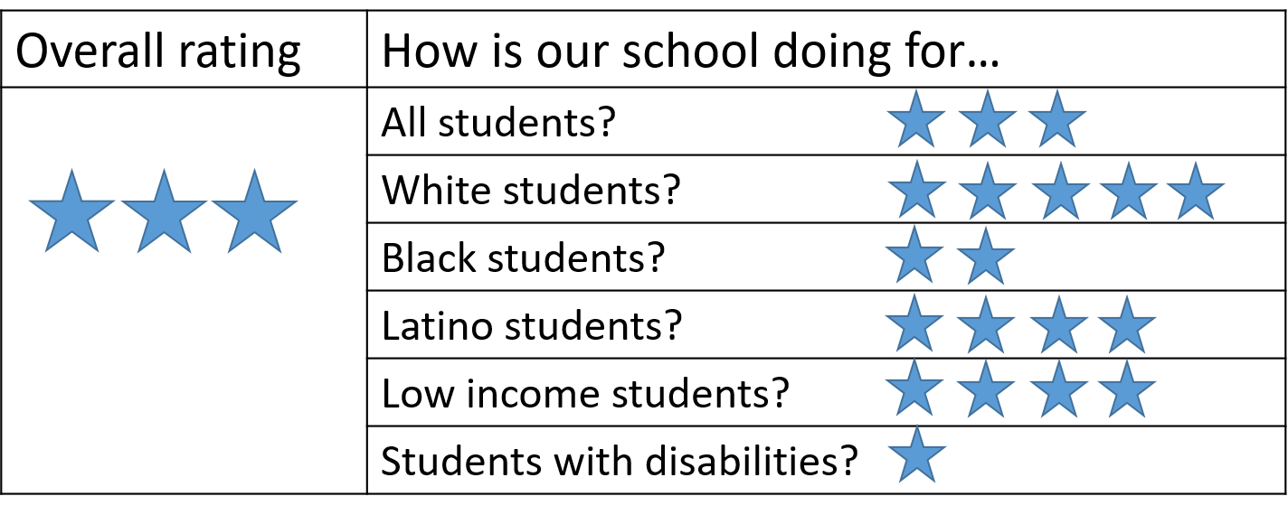
What are some viable definitions?
If a state calculates scores or ratings for each group, it could use those to define “consistent underperformance”
For example, any school getting a total score of 3 or lower for any group could be considered consistently underperforming.

Slide 64
Another is to look at whether schools are on-track to meet state goals.
States could say that any school that is off-track for meeting state goals for 2 or more years is consistently underperforming.

Slide 65
Definitions to watch out for
States should not define consistently underperforming based on the size of within-school achievement gaps.
A school that is not doing well for its Latino students should have to take action regardless of how it’s doing for its White students. What matters most is the school’s results for each group, not how those results compare with other groups.

Slide 66
Definitions to watch out for, continued.
States should not define consistently underperforming as “performing as badly as the bottom 5 percent of schools are for all students.”
Doing so would mean that the only schools that would need to take action are those that are doing as badly for a group of students as the absolute lowest performing schools in the state are for all kids. Schools that are only slightly higher performing for all groups of students — say, at the 6th percentile — would get a free pass.

Slide 67
Definitions to watch out for, continued
States should not in any way cap the number of schools that can be identified as consistently underperforming for a group.
In other words, states should not define consistently underperforming as the 10 percent or 15 percent (or 20 percent or 30 percent) of schools with the lowest achievement for any group. Doing so sends the message that results of individual groups of students only matter in those 10 percent or 15 percent of schools.

Slide 68
Important: It’s not enough to have a list of schools that are consistently underperforming. The state has to ensure that if a school is consistently underperforming, it gets a lower rating.

Slide 69
In the case of Wilson, if we hadn’t averaged together results for all groups of students, the school would have gotten a 4. Because the school is consistently underperforming for two groups of students, the maximum rating it should get is a 3.

Slide 70
A summary of key questions
What indicators is the state including in school ratings? Can all indicators be disaggregated by student group?
What are the expectations for performance and improvement on each indicator, for all students and each student group?
How much do results on each indicator count?
Do results of each individual group of students count in school ratings? How much do they count?
How does the state define “consistently underperforming” for a group of students?
What happens to a school’s rating if the school is consistently underperforming for one or more student groups?

