Slide 1
SUBTITLE
October 20 – 21, 2016
Omni Houston Hotel at Westside
Houston, Texas

Slide 2
Working Session: State is tweaking its ratings

Slide 3
Goals for our time together
Identify a core set of questions for assessing a current state accountability system
Apply those questions to current systems
Discuss possibilities for tweaking these systems

Slide 4
Key Questions to Ask
Are ratings based largely on measures of student academic achievement and attainment?
Are the expectations for performance on the measures ambitious and achievable? Do they expect more progress from groups starting further behind?
Does the performance of each group of students matter in the ratings?
Is a school’s rating impacted if the school is consistently underperforming for one or more groups of students?
Is a school’s rating impacted if fewer than 95% of students—overall or for any group—participate in the assessment?

Slide 5
A few notes as we dig in…
These systems can be profoundly complex. We’re not going to dig into every detail, but rather focus on the most important questions.
Some of the answers are objective. Others will be subjective.
Sometimes the answer is “We need more information.”

Slide 6
Are ratings based largely on measures of student academic achievement and attainment?

Slide 7
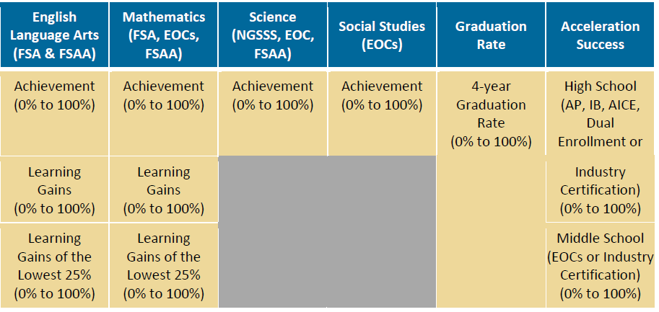

Slide 8
Reminder: What does ESSA require?
States must annually rate schools based on the following indicators, all of which (except #3) have to be broken down by student group:
Academic Achievement a. Proficiency on annual assessments b. May include growth for high schools 2. Other Academic Indicator a. For high schools – graduation rate b. For non-high schools – growth or another valid, reliable,
statewide academic indicator 3. Progress toward English language proficiency for English learners 4. Other valid, reliable, comparable and statewide measure of school quality

Slide 9
Are the expectations for performance on the measures ambitious and achievable? Do they expect more progress from groups starting further behind?

Slide 11
Reminder: What does ESSA require?
States set long-term goals on at least tests and graduation rates. These goals must be set for all group of students, and must expect more progress from the groups that are further behind.

Slide 12
Does the performance of each group of students matter in the ratings?

Slide 14
Reminder: What does ESSA require?
States must rate schools annually based on the performance of all groups of students—students from major racial/ethnic groups, low-income students, students with disabilities, and English learners – on all of the indicators

Slide 15
Is a school’s rating impacted if the school is consistently underperforming for one or more groups of students?

Slide 16
Reminder: What does ESSA require?
Ratings must make clear when any group of students—students—students from major racial/ethnic groups, low-income students, students with disabilities, and English learners – is consistently underperforming.

Slide 18
Is a school’s rating impacted if fewer than 95% of students—overall or for any group—participate in the assessment?

Slide 20
Reminder: What does ESSA require?
States must provide a clear explanation for how they will factor the 95 percent participation requirement, overall and by student group, into the school accountability system.

Slide 21
Key Questions to Ask
Are ratings rating based largely on measures of student academic achievement and attainment?
Are the expectations for performance on the measures ambitious and achievable?
Does the performance of each group of students matter in the ratings?
Is a school’s rating impacted if the school is consistently underperforming for one or more groups of students?
Is a school’s rating impacted if fewer than 95% of students—overall or for any group—participate in the assessment?

Slide 22
Another state

Slide 23
Key Questions to Ask
Are ratings rating based largely on measures of student academic achievement and attainment?
Are the expectations for performance on the measures ambitious and achievable? Do they expect more progress from groups starting further behind?
Does the performance of each group of students matter in the ratings?
Is a school’s rating impacted if the school is consistently underperforming for one or more groups of students?
Is a school’s rating impacted if fewer than 95% of students—overall or for any group—participate in the assessment?

