Slide 1
SUBTITLE
Improvement Planning Deep Dive: FUNDING
October 20 – 21, 2016
Omni Houston Hotel at Westside
Houston, Texas

Slide 2
ESSA’s Big “School Improvement Fund”
ESSA will provide about $1 billion per year in funding to support improvement plans for struggling schools – identified based on the indicators and ratings we have been talking about:
Bottom 5% of Title I schools
Schools with one or more underperforming groups of students
States will need to make big decisions about how those funds get distributed and used to support improvement activities in those schools.
However … before we talk about those decisions, let’s review some important context to keep in mind.

Slide 3
Key Context for State Decisions about School Improvement Funds
Many improvement activities will not require additional funding (especially if “needs assessment” is honest and probing).
Schools can often leverage existing resources more effectively for school improvement.
Other kinds of federal, state, and local dollars can be used to fund improvement activities.

Slide 4
1. Many improvement activities will not require additional funding
School improvement planning requires a “needs assessment” to determine what the school must do differently to improve outcomes.
Sometimes that can mean adding new programs or upgrades, but it can often mean changing adult practices in basic but powerful ways.

Slide 5
1. Many improvement activities will not require additional funding
EXAMPLE from an improvement plan for Chandler Elementary School, Worcester, Massachusetts:
“The school leaders know that in order to rapidly accelerate the academic achievement of all Chandler Elementary students they must develop the competencies of the all adults in the school and continuously monitor instructional practice in tandem with close monitoring of student achievement. … The principal and assistant principal have developed a schedule for daily classroom visits or mini-observations which include observations of student engagement with learning tasks, elements of the organization of the classroom, language-rich interactions, connection of the lesson to learning standards and objectives, evaluation of the rigor of learning tasks and other aspects of the Worcester Public Schools Framework for High Quality Teaching and Learning …”

Slide 6
2. Schools can often leverage existing resources more effectively
The most common use of targeted school improvement funding is teacher professional development.
In most schools, teachers already have various kinds of professional development opportunities.
Research shows that how that time is spent matters hugely.

Slide 7
2. Schools can often leverage existing resources more effectively
Example: Time set aside for teachers to collaborate with colleagues is the single biggest cost for professional development at the school level.
One study followed a group of Title I schools using this strategy as a primary activity for school improvement.
Student outcomes improved when teacher teams used an explicit process to 1) analyze data to identify student learning problems, 2) select and try new instructional strategies, 3) reconvene and analyze student work for evidence of impact, and 4) keep honing teaching strategies until students achieved the desired results.
Student outcomes did not improve when teachers used the time in less focused and structured ways, e.g., when they used the time to “share ideas.”

Slide 8
3. Other kinds of federal, state, and local dollars can be used to fund improvement activities
Federal Title I, Part A – “Schoolwide” Option
Title I, Part A is the biggest source of federal K-12 funding: + $14 billion
Qualifying Title I schools can opt to spend those funds to support a “schoolwide” improvement plan based on needs assessment.
Requires 40% poverty threshold, but ESSA allows states to waive that requirement.
70 percent of Title I schools already use this “schoolwide” option.
Schools have broad flexibility in selecting improvement activities, as long as they addresses a priority identified in the needs assessment.
Schools can “consolidate” other federal funds with these funds.
HOWEVER, many schools still do not understand/believe they have this much flexibility, and states have not been diligent in addressing misunderstandings.

Slide 9
3. Other kinds of federal, state, and local dollars can be used to fund improvement activities
In September, U.S. ED issued guidance with examples of how Title I “Schoolwide” funds can be used for a range of improvement activities, such as
High-quality preschool or full-day kindergarten
Recruitment and retention of effective teachers
Instructional coaches to provide high-quality, school-based professional development
Increased learning time
Evidence-based strategies to accelerate the acquisition of content knowledge for English learners
Activities to increase access to and prepare students for success in advanced coursework
Counseling, mentoring, or other strategies to improve non-academic skills
Interventions to improve school climate
Equipment, materials, and training to analyze student achievement data to monitor progress, alert the school to struggling students, and drive decision making
“Response-to-intervention” strategies for early identification of students with learning or behavioral needs and tiered interventions based on need
Activities shown to be effective at increasing family and community engagement in the school

Slide 10
3. Other kinds of federal, state, and local dollars can be used to fund improvement activities
Federal Title II, Part A
Funds activities to improve teaching and school leadership: + $2 billion
Funds more often spent at district level, but districts could target them to address teacher- and leader-related needs in school improvement plans
Example: Support and training for principals and other school leaders to lead school improvement efforts
Example: Support and training for teachers in common areas of student need / instruction
Example: Addressing inequities in access to qualified and effective teachers and leaders
Title II funds often considered in isolation, not aligned with Title I spending or with school improvement plans and funding.

Slide 11
3. Other kinds of federal, state, and local dollars can be used to fund improvement activities
State and local funding – But that depends on your state’s context
Before the recession, many states provided dedicated funds for school improvement, in some cases tens or hundreds of millions of dollars. However, state and local funding for education is still not back up to pre-recession levels in 31 states.
We also know, from Ed Trust research, that low-income students and students of color receive fewer state and local dollars in many states.
Important to know your state context as you think about policy and advocacy.

Slide 12
From Two Federal Improvement Funds to One
NCLB 2015-16
ESSA 2017-18

Slide 13
Title I “7% Set-Aside” – Some Basics
States must set aside 7% of total Title I, Part A allocation
Out of that set-aside, states may reserve up to 5% for state activities, with the rest going to LEAs for school improvement

Slide 14
Title I “7% Set-Aside” – Some Basics, continued
Unlike SIG, almost no federal restrictions on how funds may be spent
Only restriction: Must support “evidence-based” strategies (i.e., activities, practices, interventions that have some formal research backing)
States may award grants on a formula or competitive basis
States must consider three priorities for awarding grants, but ESSA leaves the definitions mostly up to the states
Number or proportion of schools identified for improvement
Need for improvement funding
Commitment to enabling the lowest-performing schools to improve student outcomes
With approval of district, states may directly spend funds that normally would be subgranted to district to pay for school improvement activities (e.g., services or supports provided by state agency or other entities)

Slide 15
Title I “7% Set-Aside” – Some Basics, continued
Nothing in ESSA restricts states from allocating funds to consortia of districts or to education service agencies (if those entities legally qualify as “local education agencies” in a state)
Local education agencies must submit an applications to the state to receive funds
States must annually report which local education agencies and schools received funds, amount each school received, and strategies implemented in each school with support from these funds
Big change from 2008, when four states could not tell the U.S. General Accounting Office which schools received funds from the set-aside!

Slide 16
Some Major State Decision Points
Should the state allocate these funds to LEAs based using formula grants, competitive grants, or both?
To what extent should the state constrain how these funds can be used? In what ways, given the state’s unique context?
How long should the grants last? ESSA allows grants to be up to four years, and the first year can be a “planning year.”
If longer than two years, should schools be expected to show progress on leading indicators for subsequent rounds of funding?
How large should the grants be? Should the state set floors or ceilings for different types of schools?
How should the state define “need” and “commitment to … lowest-performing schools”?
Should the state allow or encourage consortia of districts or education services agencies to apply for funds?

Slide 17
That Gives States Lots of Leeway … Let’s Consider Just the First Two Decision Points
 | Less Constrained Use | More Constrained Use
Formula Grants | Georgia: For FY 2014-2015, all Priority, Focus, Alert schools received a base of $33K. Non-SIG Priority and Focus Schools received additional funds based on each school’s designation. Non-SIG Priority schools received a supplement based on the size of the school. Funds can be used for wide range of activities based the needs assessment. | Indiana: For 2015-16, eligible Priority and Focus schools can apply for either $10K or $15K to support activities in any of four areas: teacher retention, family and community involvement, increased learning time, pre-kindergarten initiatives. Schools must choose from a defined menu of interventions within each type of activity.
Competitive Grants | Incentivize Use of Diagnosis-Driven, Evidence Based Strategies: Award competitive points for deep/thorough diagnostic needs assessment; use of strategies tied to needs; selection of strategies based on higher levels of research evidence; theory of action for how will improve outcomes. | Colorado: The state has used its 1003(a) set-aside to fund three separate competitive grant programs: Diagnostic Review and Planning Grant Program Reading Ignite Literacy Grant Program Connect for Success Grant Program

Slide 18
Close Up on Colorado’s Competitive Grants
Diagnostic Review and Planning Grant Program
Eligible schools may apply for up to $50,000 to engage a state-approved provider to conduct an on-site diagnostic review (needs assessment) and an approved provider to help write improvement plan based on the findings of the diagnostic review.
Reading Ignite Literacy Grant Program
Eligible LEAs may apply for one of 1-20 grants, ranging in size from $75,000 to $125,000, to enable Priority or Turnaround schools to embed essential components of supplemental reading instruction.
Connect for Success Grant Program
Priority and Turnaround schools may apply for grants to implement structures and strategies found to be effective through the High Achieving Schools study and provide quality instruction to meet needs of minority students, students experiencing poverty, students with disabilities, and English Learners.
Source, Colorado Department of Education, https://www.cde.state.co.us/fedprograms/ti/sitig#cfsg

Slide 19
Reminder: Only Federal Constraint on Use of Set-Aside Funds Is “Evidence-Based”
Therefore, these funds could be spent on non-academic student supports, strategies to improve school climate, family and community engagement, etc. – as long as the strategy is backed by research
Example: Massachusetts “Wraparound Zones” (WAZ) Grant Program
Funds awarded to 32 “turnaround” schools in seven districts, 2011-14
Addressed the holistic needs of students by enhancing school climate; identifying students with nonacademic needs; integrating social service resources; engaging families. Many grantees created partnerships with local mental health clinics and other community providers.
A quasi-experimental research study found that WAZ contributed to higher rates of student improvement on state math and language arts assessments. (AIR, 2015)

Slide 20
State “Design Decisions” Can Have Huge Consequences … Thought Exercise
ED’s proposed ESSA regulations would require the 5% lowest-performing schools to be funded at $500K per year, while schools identified for consistent underperformance among one or more student groups would receive $50K per year.
What would that look like given current Title I allocations?
Turns out, the funds would run out pretty quickly …

Slide 21
State “Design Decisions” Can Have Huge Consequences … Thought Exercise
State | Title I Funds (2015) | 7% Improvement "Set-Aside" | Title I Schools (2014) | How many "lowest-performing 5% of Title I schools"? | Number of those schools that could be funded at $500K minimum per school | Number of those schools that could NOT be funded with $500K floor | Percent of schools that could not be funded
Alabama | 221,717,283 | $15,520,210 | 901 | 45 | 31 | 14 | 31%
California | 1,684,685,737 | $117,928,002 | 7092 | 355 | 236 | 119 | 33%
Colorado | 150,077,888 | $10,505,452 | 657 | 33 | 21 | 12 | 36%
Delaware | 44,353,281 | $3,104,730 | 182 | 9 | 6 | 3 | 32%
Georgia | 499,202,660 | $34,944,186 | 1608 | 80 | 70 | 11 | 13%
Hawaii | 47,116,137 | $3,298,130 | 191 | 10 | 7 | 3 | 31%
Illinois | 663,983,900 | $46,478,873 | 3240 | 162 | 93 | 69 | 43%
Indiana | 258,377,005 | $18,086,390 | 1513 | 76 | 36 | 39 | 52%
Kentucky | 211,845,665 | $14,829,197 | 1079 | 54 | 30 | 24 | 45%

Slide 22
State “Design Decisions” Can Have Huge Consequences … Thought Exercise
State | Title I Funds (2015) | 7% Improvement "Set-Aside" | Title I Schools (2014) | How many "lowest-performing 5% of Title I schools"? | Number of those schools that could be funded at $500K minimum per school | Number of those schools that could NOT be funded with $500K floor | Percent of schools that could not be funded
Louisiana | $284,164,949 | $19,891,546 | 1123 | 56 | 40 | 16 | 29%
Maryland | $195,892,739 | $13,712,492 | 795 | 40 | 27 | 12 | 31%
Michigan | $498,675,460 | $34,907,282 | 2337 | 117 | 70 | 47 | 40%
Minnesota | $148,615,160 | $10,403,061 | 884 | 44 | 21 | 23 | 53%
New York | $1,104,439,248 | $77,310,747 | 4651 | 233 | 155 | 78 | 34%
North Carolina | $417,088,622 | $29,196,204 | 2155 | 108 | 58 | 49 | 46%
Ohio | $558,320,583 | $39,082,441 | 2899 | 145 | 78 | 67 | 46%
Tennessee | $283,709,751 | $19,859,683 | 1511 | 76 | 40 | 36 | 47%
Texas | $1,320,732,434 | $92,451,270 | 7066 | 353 | 185 | 168 | 48%
Washington | $230,247,957 | $16,117,357 | 1572 | 79 | 32 | 46 | 59%

Slide 23
Bottom Line
This is not just about how states will distribute a big pot of school improvement funding.
This is about whether states will leverage the money and the process to encourage schools and districts to think deeply and strategically about improvement, taking into account all available resources.

Slide 24
Discussion
Big State Decisions for “Set-Aside”
Key Context to Keep in Mind
Should the state allocate funds to LEAs based using formula grants, competitive grants, or both?
To what extent should the state constrain how funds can be used? In what ways, given the state’s unique context?
How long should the grants last? ESSA allows grants to be up to four years, and the first year can be a “planning year.”
If longer than two years, should schools be expected to show progress on leading indicators for subsequent rounds of funding?
How large should the grants be? Should the state set floors or ceilings for different types of schools?
How should the state define “need” and “commitment to … lowest-performing schools”?
Should the state allow or encourage consortia of districts or education services agencies to apply for funds?
Many improvement activities will not require additional funding (especially if “needs assessment” is honest and probing).
Schools can often leverage existing resources more effectively for school improvement.
Other kinds of federal, state, and local dollars can be used to fund improvement activities.

Slide 25
Additional Information for Context →

Slide 26
Inflation-Adjusted Change in K12 Spending Per Student, 2008-2014
Source: Center on Budget & Policy Priorities, January 2016.

Slide 27
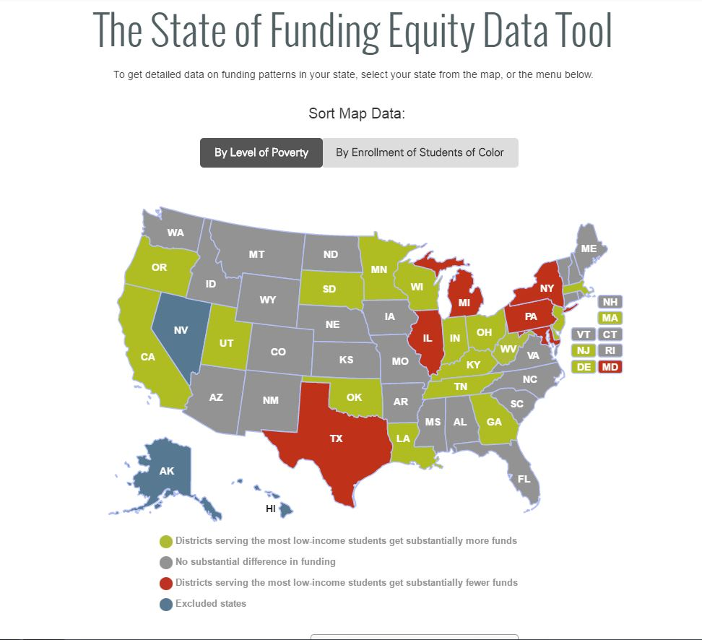
State and Local Funding Equity

Slide 28
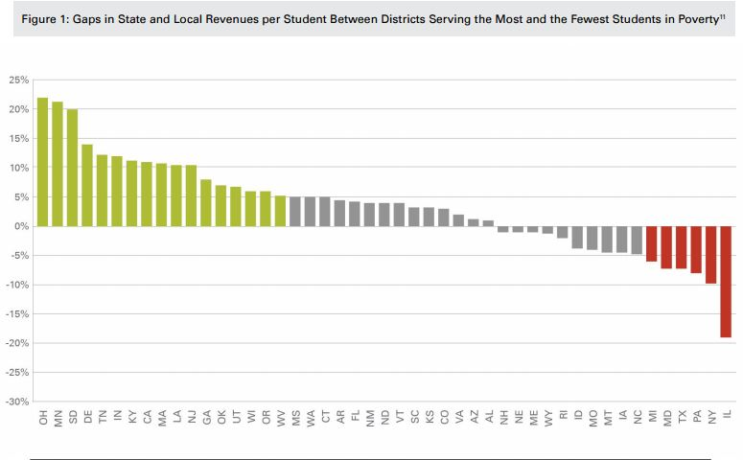

Slide 29
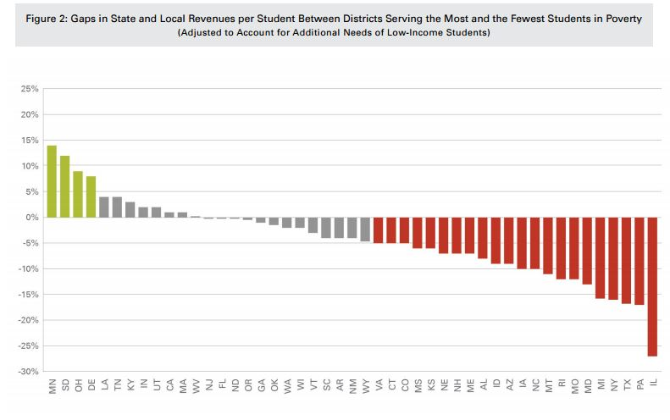

Slide 30
