Slide 1
SUBTITLE
Parent and Community Engagement
Deep Dive
October 21, 2016
Omni Houston Hotel at Westside
Houston, Texas

Slide 2
40 Years of research tells us…. Family engagement is one of the strongest predictors of a child’s success in school.
Notes:
Decades of research confirms what we already knew: family & community engagement matters for student success in school.

Slide 3
The Challenge
Families & community partners may not feel like valued partners in school improvement efforts.
Engagement efforts can be uncoordinated and separate from school improvement efforts.
Notes:
But, we know that far too often families and communities do not feel like valued partners in helping their schools improve.
Maybe that’s because schools overlook families and communities as a source of information, ideas or feedback.
Maybe it’s because there are barriers that exist for meaningful participation – like language barriers or even when and how engagement occurs. Like meetings that conflict with work or without child care availability.
Or maybe it’s because family and community engagement hasn’t been a priority for the state, school district or school. One researcher (Kressley) described these uncoordinated engagement activities that are separate from school improvement as “random acts of family involvement.”

Slide 4
ESSA & Engagement Opportunities: Broad Overview
School Improvement
Accountability
ESSA
Innovative Assessment Pilots
English Learners
Teacher & Leader Quality
Charter Schools
Notes:
ESSA includes many requirements for stakeholder engagement – in a variety of areas. Today, we’ll focus only on the requirements outlined in the accountability section that are related to school improvement.
Background info:
- English Learners: in order to receive Title III funding to support EL programs, state and district plans must explicitly include family and community stakeholder engagement as part of their EL strategy ,and implementation.
Innovative Assessment pilot: if states apply for this pilot the design and implementation plans should be developed in consultation with state stakeholders
Title II funding requires state and local districts to work with stakeholders to develop assess, and refine strategies to meet state’s goals around high quality teachers and leaders.
Charter applications must be developed in consultation with stakeholders.

Slide 5
ESSA Accountability & New Opportunities
School Ratings
Identification of Low Performing Schools
School Improvement Process
Notes:
Over the time together at the Boot Camps, we’ve talked about how ESSA’s new accountability systems can support transparent school ratings based on meaningful indicators.
We’ve also talked about how these school ratings can help identify schools that are low performing and need support to improve.
But, our focus today will be on what really matters – once we know how schools are faring, and after we use that info to identify poorly performing schools, what do we do next? How can we improve schools that need help?
And how does ESSA give us – as parents and community partners – the backing we need to be valued in the school improvement process?

Slide 6
Family, Community Engagement & School Improvement
Schools that are identified as needing:
Comprehensive Support & Improvement
Lowest-performing 5% of Title I schools;
Graduation rates at or below 67%
Targeted Support & Improvement:
Schools with any student subgroup that is “consistently underperforming”
Schools with a subgroup performing at the level of the lowest-performing 5% of all Title I schools.
States must use 7% of Title I funding for school improvement activities
Notes:
There are two main ways that ESSA requires meaningful engagement with families and community partners in the school improvement process.
Comprehensive support and improvement schools and
Targeted support and improvement schools.
ESSA requires States to use 7% of its Title I funding to support these school improvement activities. States have the option of whether to make this a formula or competitive funding program (see the funding breakout session).
Let’s dig deeper into each of these areas to identify the specific ways to become engaged.

Slide 7
Comprehensive Support & Improvement (CSI) Schools
School district -with stakeholders - conducts needs assessment, designs and implements CSI Plan
Plan includes: evidence based interventions based on needs assessment; IDs resource inequities
Plan approved by school, school district and State
State monitors & periodically reviews. If schools do not improve within 4 years, State determines more rigorous interventions.
State tells school district which schools are identified for CSI
Notes:
For both Comprehensive & Targeted schools, ESSA moves away from NCLB’s “gotcha” mentality of identifying low performing schools and instead uses identification as a way to support improvement and add resources.
In CSI schools, Districts have the responsibility for developing improvement plans for these schools. And the MUST be developed in consultation with local stakeholders including families and community partners.
Stakeholders will have an opportunity to participate in the needs assessment and have a voice in making recommendations for interventions, programming, or resources that are needed to improve the school.

Slide 8
Targeted Support & Improvement Schools
States tells school district where any subgroup is consistently underperforming
State ensures school district notifies each school
School - with stakeholders - must design a school-level targeted support and improvement plan
School district approves & monitors plan
If plan is unsuccessful after a certain number of years, the school district takes additional action
Notes:
In addition to CSI schools, ESSA identifies schools that on the surface look like they’re performing okay but digging into the data deeper reveals that as least one subgroup of student is ‘consistently underperforming’.
These schools will be identified as needing Targeted Support and Intervention.
In these schools the school has the responsibility of developing the improvement plan. And they must develop this plan with stakeholders.
Again, this is an excellent opportunity for families and communities to engage in the improvement process. These schools will have to design a school-level improvement plan which must include evidence-based interventions.
Let’s briefly talk about evidence-based interventions.

Slide 9
Key Questions to Ask to Increase Engagement
Being proactive & reactive, ask school leadership about:
Opportunities for parents to be part of any existing or emerging school improvement efforts.
Are there school committees/workgroups/meetings happening that parents can be a part of?
Engaging parents in the design and implementation of the needs assessment.
Engaging parents in the selection of evidence based interventions that address needs.
Current or future communications/outreach to parents – what’s the plan? How will it be publically available & accessible?
Strategies to broaden stakeholder voice if needed.

Slide 10
Evidence Based Interventions: Sample Questions
Sample Questions to Consider/Ask:
What evidence exists to support this intervention?
Were studies conducted in settings and with populations relevant to the local context (e.g., EL and SWD)?
How will we know whether the intervention is working?
What can we expect if we use this intervention, what does success look like and how will it be measured?
USED Guidance http://www2.ed.gov/policy/elsec/leg/essa/guidanceuseseinvestment.pdf
Notes:
You don’t need to know everything or anything about evidence-based interventions to be an active participant in the school improvement process.
The key is knowing what the law requires and the right questions to ask.
So, now you know that for Comprehensive Support and Improvement Schools and Targeted Support and Improvement Schools both must use evidence-based interventions to support their improvement.
But what does this mean?
Essentially, ESSA says in order for an intervention to be considered “evidence based” it must have research to support it. That’s important because we would never give our children medicine that is unsupported by research so why should we give them interventions that are unsupported by research.
But we don’t need to know the research behind every intervention or idea to propose it. Proposing ideas and letting the school and district determine the evidence base is just fine.
Also, it’s good to know some key questions to ask when schools and districts propose interventions.

Slide 11
Oklahoma Case Study
Challenge: Students with disabilities (SWDs) were performing much worse than all other students on state assessments.
Root cause analysis: Teachers had never been trained to educate students with disabilities, even though most SWDs spend their day in general education classroom.
Goal: Group of parents established a goal of getting every teacher 2 days of professional development per school year.
Action Plan: Diverse group, supported by data, evidence based interventions.
Victory!!!!

Slide 12
Putting it All Together: Summary
ESSA includes many opportunities for family & community engagement in school improvement
Comprehensive & Targeted Support & Improvement Schools require ongoing-engagement
Knowing key questions to ask about school improvement efforts, especially about evidence based interventions, will help drive school improvement

Slide 13
SUBTITLE
Jose L. Rodriguez
Director of Parent and Community Engagement
October 20 – 21, 2016
Omni Houston Hotel at Westside
Houston, Texas

Slide 14
Who We Are and What We Do
The National Council of La Raza (NCLR)—the largest national Hispanic civil rights and advocacy organization in the United States—works to build a stronger America by creating opportunities for Latinos.
Through its network of nearly 300 affiliated community-based organizations, NCLR reaches millions of Hispanics each year in 37 states, Puerto Rico, and the District of Columbia.
Founded in 1968, NCLR is a private, nonprofit, nonpartisan, tax-exempt organization headquartered in Washington, DC, serving all Hispanic subgroups in all regions of the country. It has state and regional offices in Chicago, Los Angeles, Miami, New York, Phoenix, and San Antonio.

Slide 15
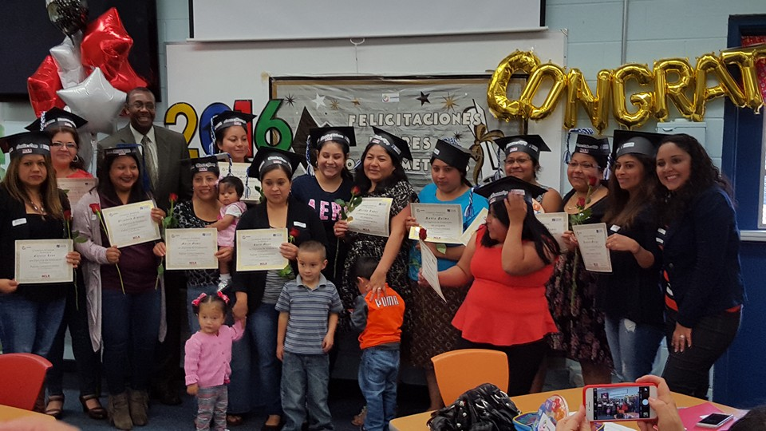
NCLR and Latino Parent Engagement
What We’ve Learned:
Latino parents do not usually receive enough or culturally and linguistically relevant information from schools.
Latino parents are eager to receive this information since schooling and their child’s education is of critical importance to families.
Latino parents place tremendous responsibility on themselves to support their children’s academic success.
Notes:
Through research and our work with parents we have learned that
Latino parents do not usually receive enough or culturally and linguistically relevant information from schools.
Latino parents are eager to receive this information since school and their child’s education is of critical importance to families.
Latino parents place tremendous responsibility on themselves to support their children’s academic success.
Far to often parents of color are excluded from school committees and their children do not have access to a high quality education.
Parents can become more effective advocates for their children when they learn how to engage with the school system and when they learn about strategies they can use to navigate their children’s stages of development as they progress through their school years.

Slide 16
Guiding Principles for Engaging Latino Families
Education is the most important issue for Latino families.
Educational attainment, English fluency, or economic status need not be obstacles.
Understand that many parents, especially recent immigrants, can be overwhelmed by the school system.
School improvement plans must include a strategy, with measurable goals, to effectively engage Latino parents.
Schools must take the initiative to develop meaningful relationships.
Engagement needs to be built on the values and strengths of the Latino culture.
Notes:
NCLR has effectively engaged, and helped others engage, Latino parents in their children’s education for over 20 years. During the course of this work, NCLR has identified the grounding principles that follow for all of its work with Latino parents.
Guiding Principles for Engaging Latino Parents
Education is the most important issue for Latino parents, who want to be involved in their children’s education.
Latino parents’ own educational attainment, English fluency, or economic status need not be obstacles in a school’s efforts to successfully engage them.
Schools must understand that many parents, especially recent immigrants, can be overwhelmed by the school system and feel inadequately prepared to engage with it in a meaningful manner.
School improvement plans must include a strategy, with measurable goals, to effectively engage Latino parents.
Schools must take the initiative to develop meaningful relationships with Latino parents, creating the structures and resources to facilitate their engagement—Latino parents will respond.
The most effective engagement of Latino parents has occurred when a school builds on the values and strengths of the Latino culture, managing the dynamics of cultural differences and acquiring the cultural knowledge of the families it serves.

Slide 17
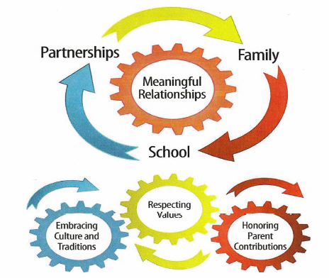
NCLR Parent Engagement Model
Tapping into Families’ Funds of Knowledge
“…this refers to the historically accumulated and culturally developed bodies of knowledge and skills essential for household or individual functioning and well-being” (p. 133).
-Moll, Amanti, Neff, and Gonzalez, 2001
Notes:
What makes the NCLR Parent Engagement model unique is the inclusion of:
Embracing culture and traditions.
Respecting our families values
And honoring parent contributions.
At the heart of the model is “Meaningful Relationships” This is a relationship that is based on mutual respect and support. This is a Win-Win situation between the family and the parties associated. We look at partnerships be it a Community based organization, a faith based organization working with families and connecting them to the schools where there children attend. At NCLR our Affiliates may be social service agencies who work provide social services to families on a daily basis. The families may need help connecting with the schools, so our Affiliate contacts NCLR and we provide the curriculum and the training and serve as a bridge between the CBO, the families and the schools.
Castro, et al. (2014), conducted a meta-analysis of 37 studies in kindergarten, elementary and secondary schools. The results show that the parental models most linked to high achievement are those focusing on general supervision of the children's learning activities. The strongest associations are found when the families have high academic expectations for their children, develop and maintain communication with them about school activities, and help them to develop reading habits.

Slide 18
Core Qualities for Successful Parent Engagement
Family Engagement and Community Collaboration
High Expectations and High Supports
Cultural Competency
Partnerships with Institutions of Higher Education
Notes:
The program or school values and facilitates close communications and engagement with parents and families. Incorporating community assets such as parents’ native language in school and at home is encouraged and supported by all staff.
The program or school helps parents develop high expectations for their children and gives them the tools to provide high levels of support for academic, intellectual, and social growth. Parents learn how to develop a college-going culture at home.
Parent engagement builds on the cultural assets of Latinos to create a sense of community that empowers parents to help shape their children’s lives.
The program or school uses its partnerships with institutions of higher education to teach parents how to help their children prepare for college.

Slide 19
Questions to Ask the Teacher
How does my child’s score on the state assessment match up with my child’s report card grades?
If my child is earning A’s and B’s in the report card, why is it that she/he is “partially understanding” the instruction?
If the state assessment only tests English Language Arts and Math, is my child receiving instruction in the other subjects such as science and social studies?
How will I know what progress she/he is making?

Slide 20
Recruiting Parents for Your Program
For some schools, recruiting parents to engage with teachers and administrators has proven, historically, to be challenging.
The success of parent engagement programs, however, will always depend on the school’s strategic efforts to involve families and to do so in ways that foster real opportunities for impact and change within the school, family, and community.
Notes:
For some schools, recruiting parents to engage with teachers and administrators has proven, historically, to be challenging. The success of parent engagement programs, however, will always depend on the school’s strategic efforts to involve families and to do so in ways that foster real opportunities for impact and change within the school, family, and community.

Slide 21
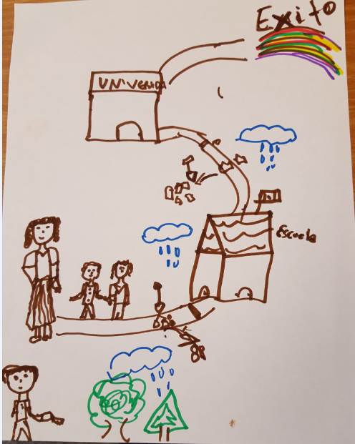
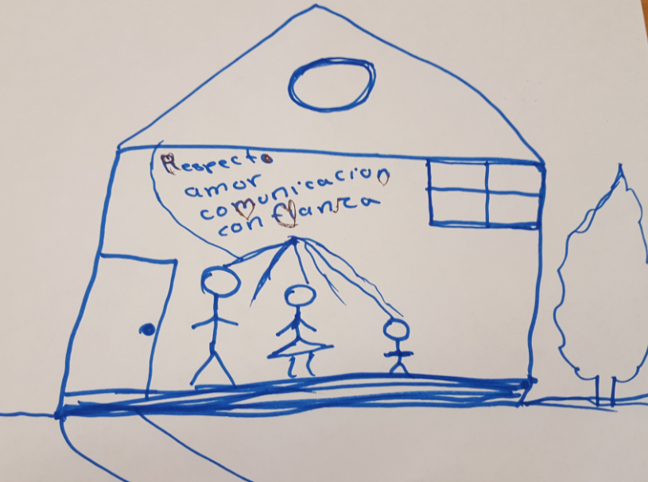
Cradle to Career Plan
Notes:
When you ask a parent what it means to an committed/dedicated/engaged parent, they usually answer that they want their children to be happy, go to school and to have more then they themselves had/have. I asked a group of parents to draw a picture of what being a committed parents looked like, most of the parents drew a picture showing a strong family foundation, and solid education Pre-K through college and a successful career.
My parents had the same goal for me and my 10 siblings. They expected us to go to school everyday, well fed, well rested, and ready to learn. We had a lot of work to do in the farm, but that was done after school. Once we arrived home from school we had to sit around the dining room table to do our homework because as soon as my dad arrived home from his day job we would go work the cotton field and the hay field. This by the way was not everyday, we did manage to get play time and entertainment, but the work we did was very hard.
My parents emphasized the importance of an education so that we would not have to work as hard as they were doing. We worked until dusk then came home and bathed, ate dinner and went to bed.

Slide 22
Outreach Strategies that Work
Make personal calls to parents to invite them to participate in the program or to attend an information session.
Get students to invite their parents to be a part of the program.
Ask local establishments that cater to Latinos (such as, bodegas, family restaurants, bakeries, Laundromats, etc.) to let you post flyers about the program. Consider also including clinics, and community-based organizations.
If your community has a Latino newspaper,
If your community has a Latino radio or television station, send them a public service announcement (PSA) about your program

Slide 23
Supporting Your Outreach and Recruitment Efforts
Personal phone calls are, by far, one of the most important, positive ingredients for engaging with parents.
Nothing can express commitment to a family stronger than a home visit. We recommend you conduct one at least once a year; twice, if possible.
Provide childcare. It will be essential to the success of your program sessions and increase parent participation.

Slide 24
Questions?

Slide 25
Thank You!! Kim Hymes Director, Federal Outreach National Center for Learning Disabilities khymes@ncld.org Washington, DC 202.637.8409 Jose L. Rodriguez Director of Parent and Community Engagement NCLR San Antonio, TX jrodriguez@nclr.org 210-212-4454 ex. 211

