Slide 1
March 1, 2021
How Schools are Funded: Policy Fundamentals
Presentation for Tennessee Dollars and Sense
© Copyright 2020 The Education Trust @EdTrust /edtrust edtrust www.edtrust.org

Slide 2





Agenda
What goes in (revenue sources)
What comes out (spending)
What goes in redux: state and district comparisons
5 Things to Advance Equity in State Funding Systems
Q&A

Slide 3
What Goes In: National Averages
Revenue Sources for the Average U.S. School District, FY2018
Source: National Center for Educational Statistics at IES, Revenues and Expenditures for Public Elementary and Secondary Education: FY 18

Slide 4
What Goes In: Federal
Federal education dollars are drawn mostly from income taxes.
Source: White House Office of Management and Budget, Historical Tables

Slide 5







What Goes In: State
State education dollars are drawn mostly from general funds powered by a range of tax sources, and the mix varies a great deal by state.
personal income
sales
corporate income
property
severance
Source: Pew Charitable Trusts, How States Raise Their Tax Dollars
licenses
other taxes

Slide 6
What Goes In: Local
Sales and Excise Taxes
Property taxes make up about 2/3 of local education dollars. The rest come from a mix of smaller revenue sources.
Income Taxes
Property Taxes
Natural Resource Taxes
Motor Vehicle Registration Fees
Utility Taxes

Slide 7
What Goes In: Summary
On average, U.S. school districts receive 45% of their funds from local sources, 47% from state sources, and 8% from federal sources (FY18).
Federal education dollars are drawn mostly from income taxes, though other federal revenue sources also play a role.
State education dollars come from a broad range of taxes, including income, sales, property, and other taxes. The mix varies a great deal by state.
Local education dollars are drawn mostly from property taxes, supplemented by a mix of smaller revenue sources.

Slide 8
What Comes Out: Federal
The federal government spent $57.3 billion on K-12 education in FY17.
ESEA/ESSA Formula Grants:
  Title I ($17.34 billion): Funding for schools and districts with high numbers of low-income students
  Impact Aid ($1.50 billion): Funding for school districts that include federal lands or serve federally connected children
ESEA/ESSA Competitive Grants
IDEA Formula Grants:
  Grants to States ($13.82 billion): Funding to support education of children with disabilities, aged 3-21
Source: Department of Education Budget Tables, FY 2021 Congressional Action

Slide 9

What Comes Out: State
State Formula Aid
1. The state uses a formula to determine how much money each district needs for the year.
State formula aid
2. The state calculates how much funding the district is expected to contribute from local sources.
Expected local contribution
3. The balance of the formula amount is provided as state aid.
Image source: IconMark, via Noun Project

Slide 10
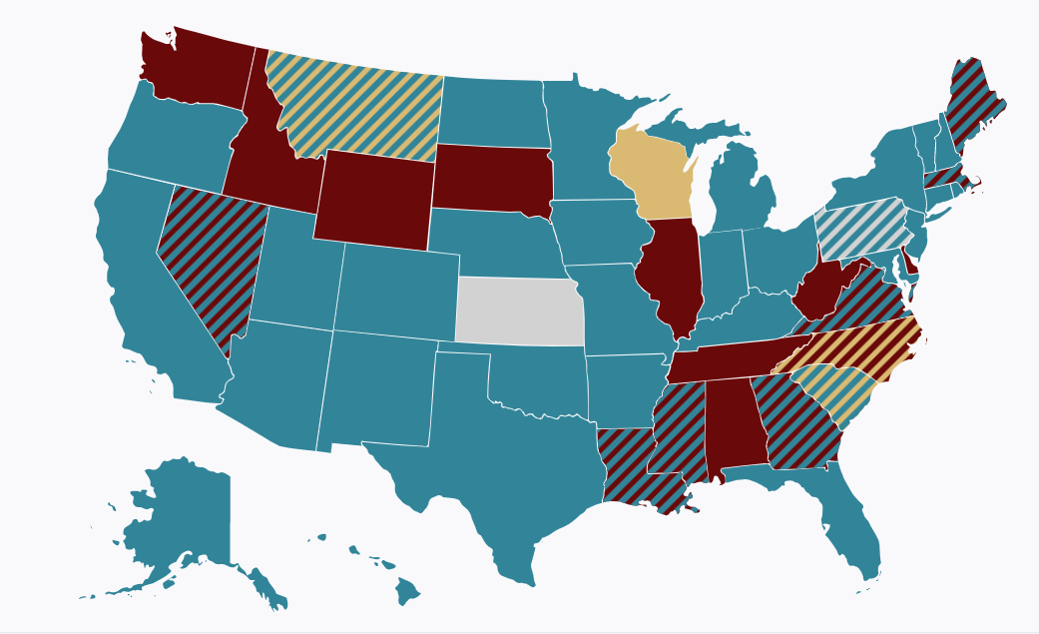
What Comes Out: State
Image source: FundEd, EdBuild

Slide 11
What Comes Out: State
Categorical Grants, e.g.:
Start-up funds or equipment reimbursements for CTE programs
School safety initiatives
Gifted and talented programs
Transportation funding
Exam fees
Pilot programs
Categorical grants are not subject to a local contribution.
State formula aid
+
Expected local contribution
Image sources: IconMark and Vectors Market, via Noun Project

Slide 12
What Comes Out: Local
Local Share
1. The state uses a formula to determine how much money each district needs for the year.
State formula aid
2. The state calculates how much funding the district is expected to contribute from local sources.
Expected local contribution
3. The balance of the formula amount is provided as state aid.
Image source: IconMark, via Noun Project

Slide 13

What Comes Out: Local
The Local Revenue Asterisk
Extra Local funds
The state calculates how much funding the district is expected to contribute from local sources. But the district often may raise more or less in actuality—without affecting the state aid amount.
State formula aid
Local Underfunding
Expected local contribution
Image source: IconMark, via Noun Project

Slide 14
What Comes Out: Summary
The federal government spent $57.3 billion on K-12 education in FY17, first and foremost on grants to districts serving low-income students, students with disabilities, and federally connected children.
States distribute most education spending as formula aid; the formula sets a target based on district funding needs and subtracts a local share, with the state providing the rest. States may also provide grants for specific purposes.
Local education spending includes districts’ contributions towards the formula target, as well as any extra dollars that the district chooses to raise and spend (if allowed by state law).

Slide 15
What Goes In Redux: State Variation
FY2018 Revenue Sources for the Average School District in:
South Dakota
Tennessee
Minnesota
Source: National Center for Educational Statistics at IES, Revenues and Expenditures for Public Elementary and Secondary Education: FY 18

Slide 16
What Goes In Redux: District Variation
South Dakota District Comparison
Minnesota District Comparison
Custer
Hopkins
Belle Fourche
Worthington
All amounts in
per-pupil dollars
Source: National Center for Educational Statistics at IES, Common Core of Data, LEA School Finance Survey (F33), FY2017-18

Slide 17
State and District Comparisons: Summary
The factors that determine the state, local, and federal shares in specific states and districts include:
  The size of the state budget and generosity of the state funding formula
  The specific student and community needs in the district, as well as other factors considered by the state formula
  Local property wealth and the ability to raise of local revenue
  The choices of local voters and/or school boards to actually raise local revenue
  The presence of federal land, or students from low-income homes, students with disabilities, federally connected children, and others eligible for federal aid

Slide 18
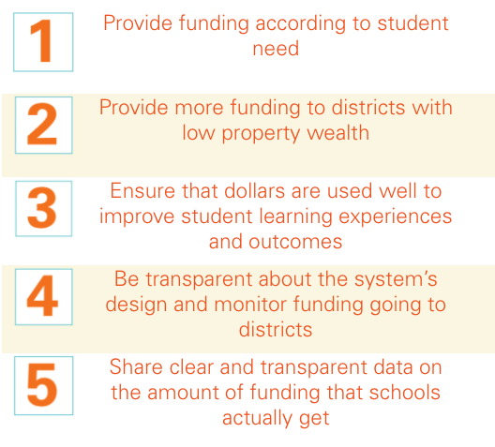
5 Things to Advance Equity in State Funding Systems
Source: Ed Trust, Five Things to Advance Equity in State Funding Systems

Slide 19

Questions

Slide 20

ELC: Advocating for School Funding Reform
Danielle Farrie dfarrie@edlawcenter.org
Research Director www.edlawcenter.org

Slide 21
WHAT WE DO:
ELC is at the forefront of state-based efforts to improve school funding equity and secure essential resources for all students.
Litigation
Advocacy
Policy
Notes:
Communications

Slide 22
HOW WE DO IT
ELC is at the forefront of state-based efforts to improve school funding equity and secure essential resources for all students.
Communications
Coalition Building
Research
Notes:
Communications

Slide 23
National Landscape: School Funding and Finance Reform
Broad Education-Focused Orgs
Education Trust
Southern Education Foundation
Fiscal Policy Orgs
Center on Budget and Policy
State-affiliates (Sycamore Institute, GBPI, North Carolina Justice Center…)
Research to Support State Policy
Cost studies
APA, AIR, Picus & Odden
Learning Policy Institute

Slide 24
National Landscape: School Funding and Finance Reform
National/multistate advocacy networks
Partnership for the Future of Learning
Litigation
Largely state focused
ELC growing as national org
Education Civil Rights Alliance
Coalition for Community Schools

Slide 25
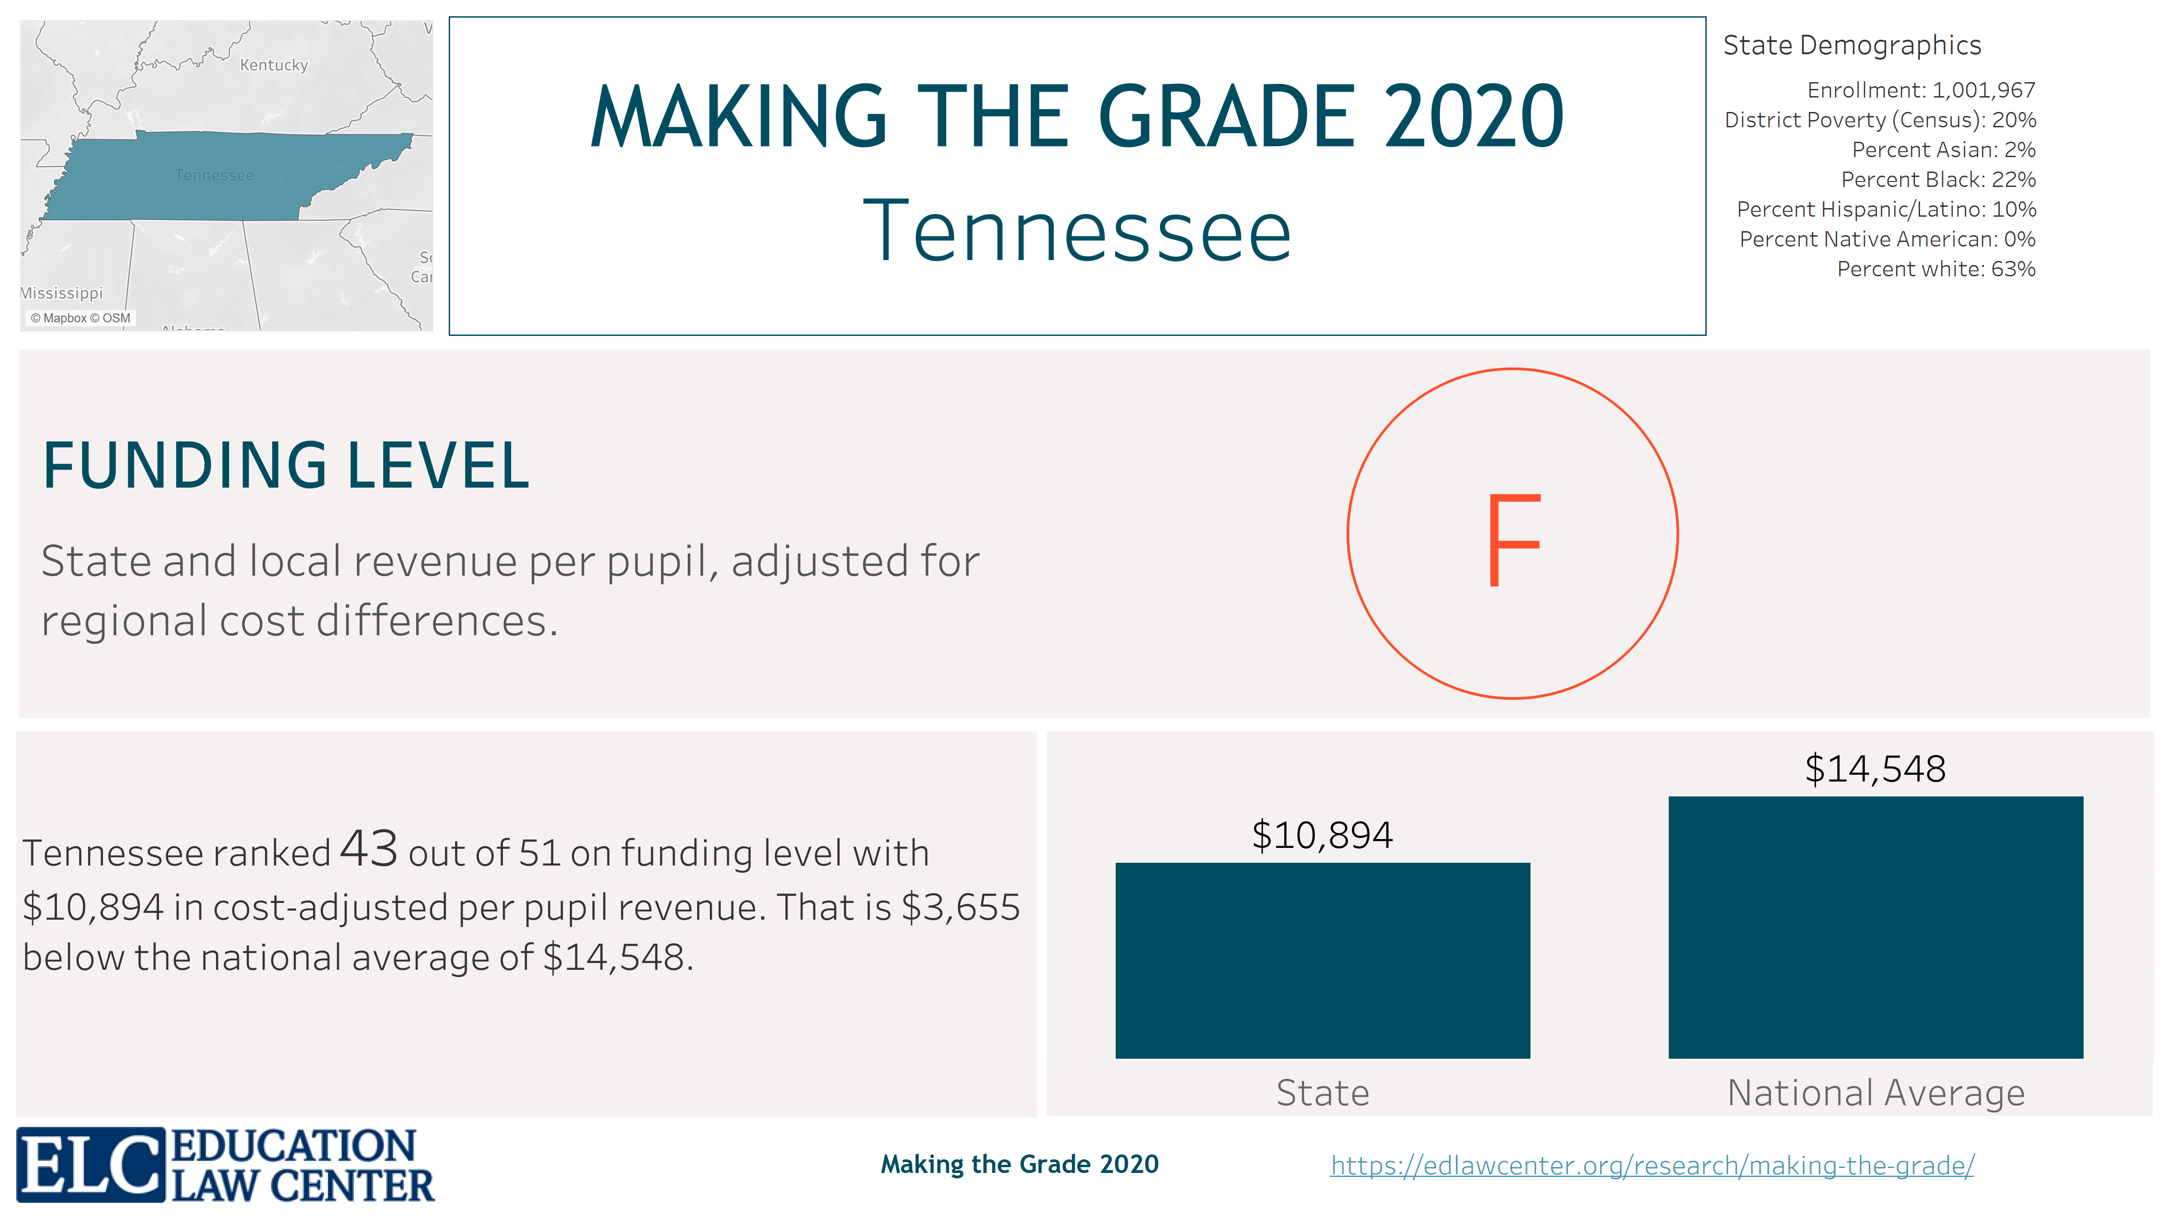

Slide 26
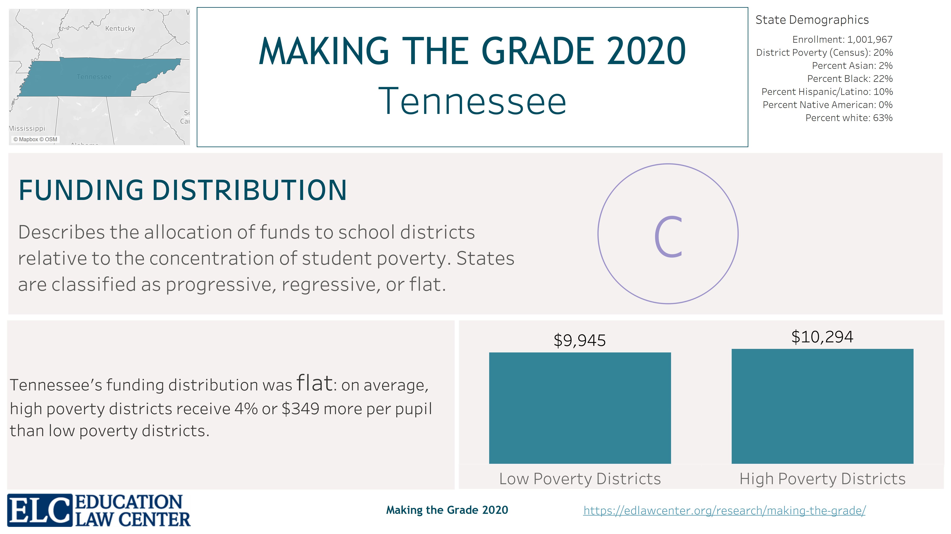

Slide 27
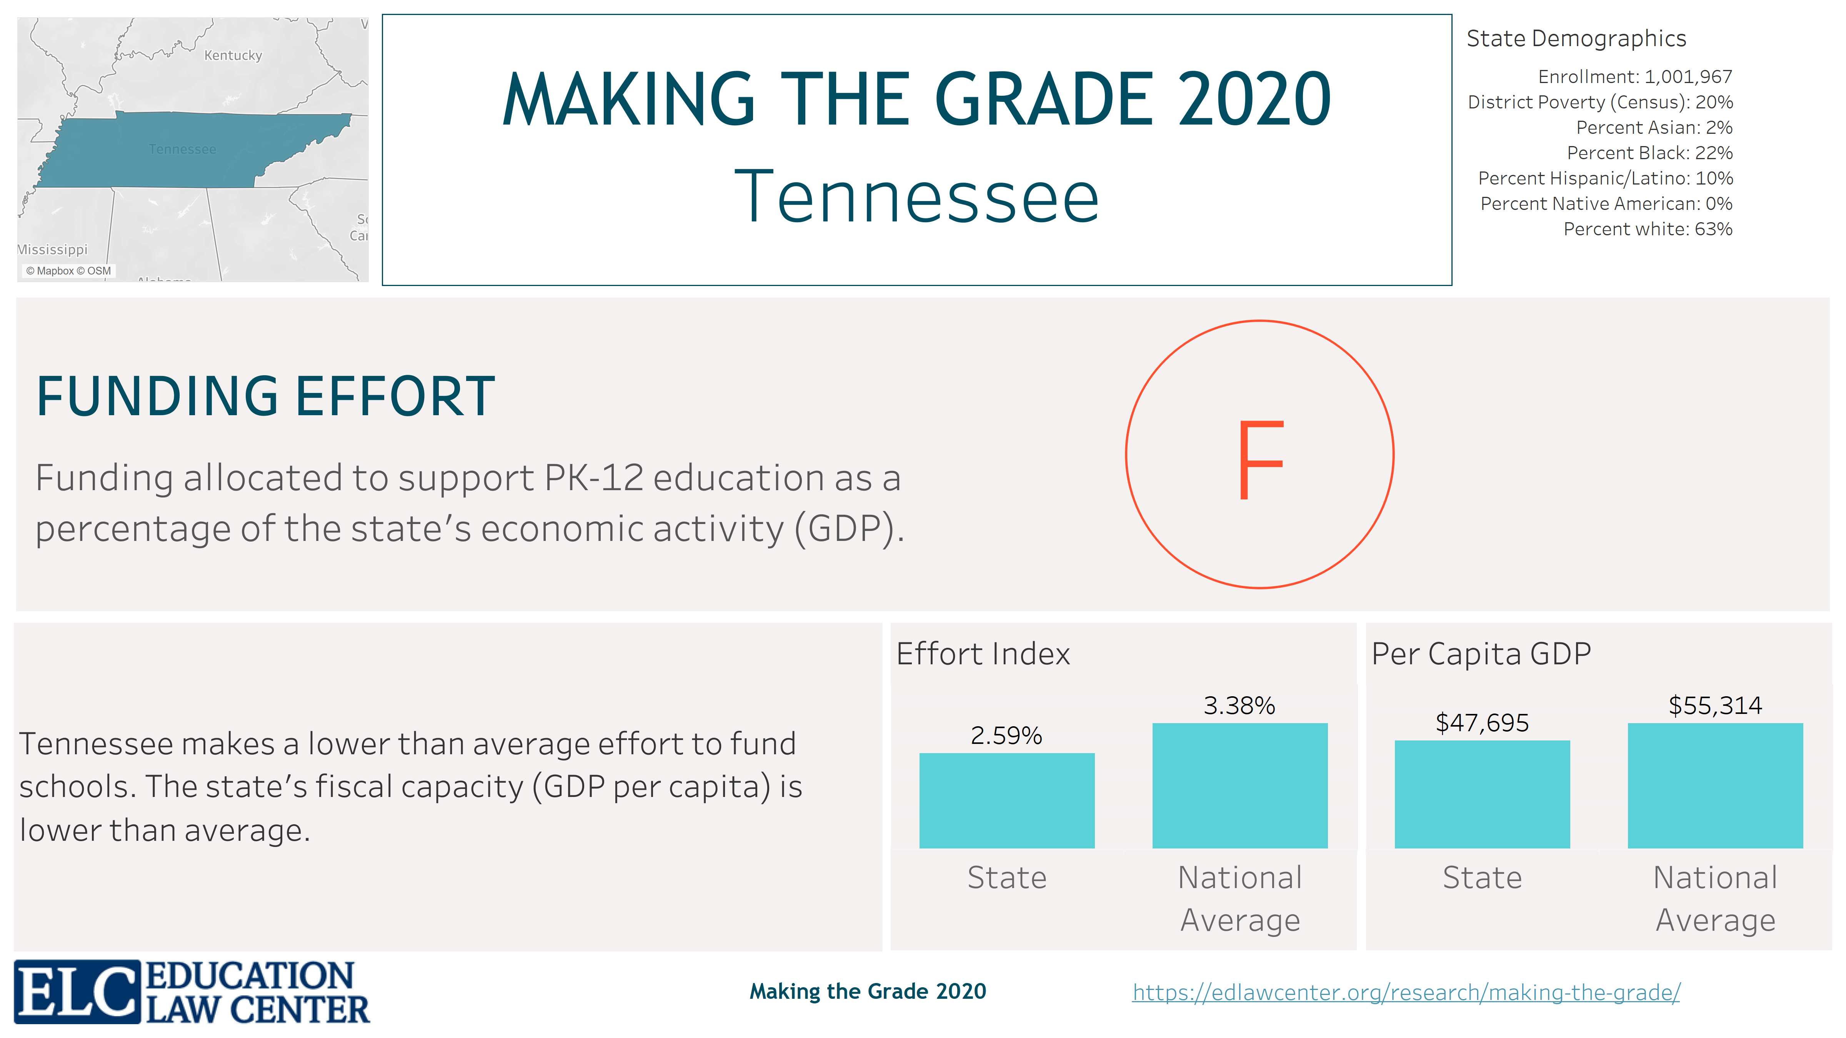

Slide 28
