Slide 1


SUBTITLE
October 20 – 21, 2016
Omni Houston Hotel at Westside
Houston, Texas

Slide 2
School Ratings
Natasha Ushomirsky, The Education Trust

Slide 3
Questions we’ll tackle today
What do we mean by “accountability”?
What are school ratings? Why do they matter?
What does ESSA require when it comes to school ratings?
Why do advocates have to pay attention?
What are the key parameters for equity-focused school rating criteria?

Slide 4
What do we mean by “accountability”?

Slide 5
School accountability is the set of policies and practices that a state uses to measure and hold schools and districts responsible for raising student achievement for all students, and to prompt and support improvement where necessary.

Slide 6
Accountability systems themselves don’t raise achievement or reduce inequities in opportunity to learn – only the hard work of districts, school leaders and teachers can do that…
But accountability systems can do several important things.

Slide 7
Accountability systems can…
Set a clear expectation that schools must raise achievement for all of their students, not just some.
Communicate whether schools are meeting those expectations – both for students overall and for each group of students they serve.
Celebrate schools that are meeting or exceeding expectations for all groups of students, and prompt action in those that are not.
Direct additional resources and supports to struggling districts and schools to help them improve.

Slide 8


The decisions states make in designing their accountability system really matter.
A well-designed accountability system shines a light on educational disparities…
But a badly designed one can actually hide schools’ underperformance for some student groups.

Slide 9
Passage of the Every Student Succeeds Act (ESSA) provides an important opportunity for states to put in place accountability systems that focus on raising achievement for all groups of students.
But they’ll be under a lot of pressure to do just the opposite.

Slide 10
One of the goals of the ESSA Boot Camps is to highlight key decisions states have to make to help you push your states to put in place accountability systems that motivate all schools to improve outcomes for all groups of students.

Slide 11
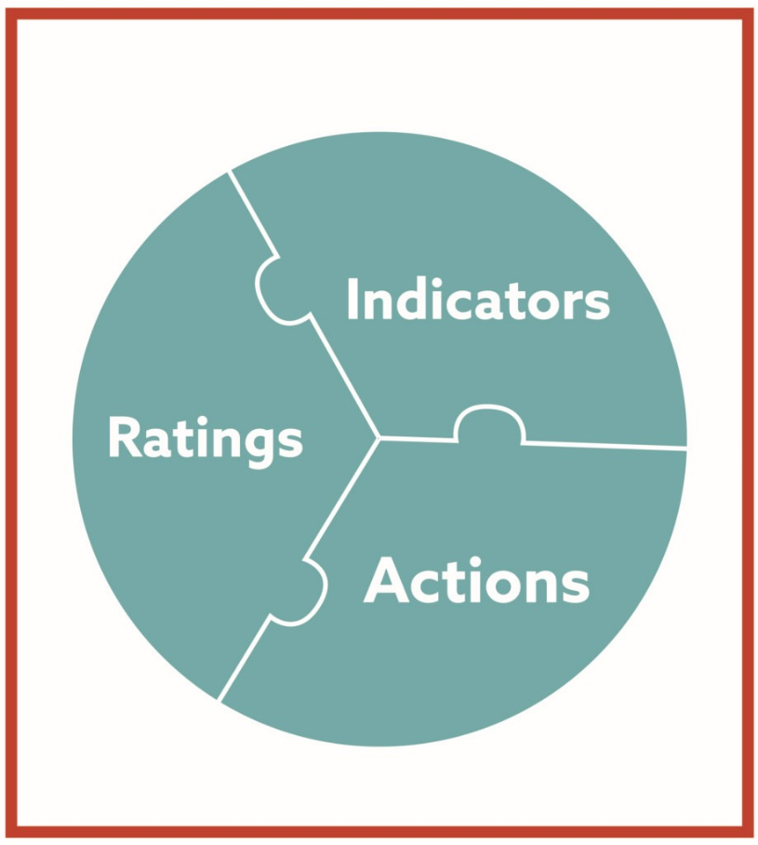
So what are those key decisions?
What indicators should we use to measure school performance?
How do we combine these indicators into a school rating?
What should states and districts do to support and ensure change in struggling schools?

Slide 12
When we met last time, we focused on the first of these decisions: What to measure.
What indicators should we use to measure school performance?
Indicators

Slide 13
Over the next couple of days, we’ll begin to dig into…
Today: How do we combine these indicators into a school rating?
Ratings
Actions
Tomorrow: What should states and districts do to support and ensure change in struggling schools? (Beginning the conversation)

Slide 14
What do we mean by “school rating”?

Slide 15
A rating is a way of signaling how a school is doing. They can be…
1 to 5 stars
Labels like…
Excellent
Good
Acceptable
Needs Improvement
Struggling
Numbers like
0 - 100
A – F Grades

Slide 16
Ratings are a key component of a school accountability system. Well-designed ratings:
Communicate expectations for preparing all groups of students for college or a meaningful career;
Communicate to educators, parents, and the public how schools are performing against these expectations, both overall and for each group of students; and
Signal that improvement is needed whenever outcomes for any group consistently do not meet expectations.

Slide 17
Ratings are especially important for equity
By defining what it means to get an “Excellent” or a “Good” rating, rating criteria can make clear that to be considered a high-performing school, a school has to be serving all of its students – not just some – well.
By identifying schools that are not meeting expectations for one or more groups of students, ratings can prompt action and help districts and states better target resources and supports.
Excellent
Good
Acceptable
Needs Improvement
Struggling

Slide 18

Of course, a rating alone is not enough.
School Rating

Slide 19
There are a number of important things that ratings, on their own, can’t do.
A school rating, on its own, can’t tell schools how to improve student outcomes
A school rating, on its own, can’t tell parents everything they need to know about a school.
And a rating, on its own, can’t tell us everything we want to know about what students experience in school.

Slide 20

That’s why the rating must be accompanied by much more detailed reports (a.k.a. “data dashboards”) that clearly present a range of information on school quality – including how schools are doing for each group of students on each indicator. And it’s why schools need to conduct a careful needs assessment to figure out what to do to improve.

Slide 21

But without ratings, parents – and everyone else – are left to cipher through pages and pages of numbers with no guidance as to whether their schools’ results are up to par.

Slide 22
And public opinion research is clear – while parents want all of those numbers, they also want ratings that tell them whether their child’s school is meeting expectations.

Slide 23
Most importantly for all of us who care about raising achievement for all students – including low-income students, students of color, students with disabilities and English learners --

Slide 24

Without meaningful ratings, it’s far too easy for schools to sweep these students’ outcomes under the rug.

Slide 25
This is why, even though Congress left a lot of decisions up to states in ESSA, they made clear that ratings have to be based on how schools are doing for all students and each student group.

Slide 26
Key ESSA Requirements

Slide 27
What does ESSA require when it comes to including results of individual student groups?
Ratings have to be based on how schools are doing for all students and each student group on all of the indicators that go into a rating.
If a school is consistently underperforming for any group of students, its rating has to reflect that, and the school has to take action to improve.

Slide 28
What does ESSA require regarding how much different indicators need to count?
Academic achievement: A measure of how schools’ proficiency rates in reading/language arts and math for all students and each student group compare with state-set goals. For high schools, states can also include student growth as part of this indicator.
Graduation rates (high school) or Another Academic Indicator (non-high schools) For high schools, a measure of how graduation rates for all students and each student group compare with state-set goals. For elementary and middle schools, this measure may be individual student growth or another statewide, valid, and reliable indicator of student learning (such as science assessment results).
English-language proficiency: A measure of the progress that a school’s English learners are making toward English proficiency.
Additional indicator of school quality or student success: Another valid, reliable, and statewide indicator of school quality.
Each of these indicators has to carry substantial weight (i.e., count a lot). Together, these three indicators have to count for more than the additional indicator of school quality or student success.

Slide 29
Why advocates need to pay attention

Slide 30
ESSA provides some important “guardrails,” but it leaves a lot of decisions about ratings up to states.
How much will results for individual groups of students count?
What does it mean to be “consistently underperforming” for a group of students?
What is “good” performance?
How much will each indicator count?

Slide 31

The way states answer these questions will make the difference between whether school ratings shine a light on educational disparities… or hide them.

Slide 32
States do not have a good track record in this area.

Slide 33
In recent years, many states chose to rate their schools based mostly or entirely on school-wide averages, ignoring how schools were doing for different groups of students.
Here is the kind of thing that happened – not infrequently – as a result.

Slide 34
Three “A” schools
School 1
School 2
School 3
Reading
Proficiency Rates
Reading Proficiency Rates
Reading
Proficiency Rates
All students: 71%
White: 77%
Hispanic: 74%
African American: 60%
Low Income: 65%
Students w/IEPs: 40%
All students: 73%
White: 89%
Hispanic: 48%
African American: 19%
Low Income: 41%
Students w/IEPs: 7%
All students: 61%
White: 95%
Hispanic: 83%
African American: 26%
Low Income: 30%
Students w/IEPs: 11%
Note: This elementary school is approximately 30% African American, 40% Hispanic, and over 50% Low-Income
Note: This elementary school is approximately 20% African American, 10% Hispanic, and 40% Low-Income
Note: This middle school is approximately 50% African American, 5% Hispanic, and over 50% Low-Income

Slide 35

Moving forward, states will face a great deal of pressure to give as many schools as possible high marks…
And to minimize the extent to which outcomes for historically underserved groups – low-income students, students of color, students with disabilities and English learners – count.

Slide 36
As advocates, we must push states to ensure that ratings truly reflect how schools are serving all groups of students – that a school cannot be considered “good” if it is not serving all students well.

Slide 37
Key parameters for equity-focused school rating criteria

Slide 38
1. Ratings must reflect how schools are serving all groups of students, including low-income students, students from each major ethnic/racial group, English learners, and students with disabilities.

Slide 39
What does this mean?

Slide 40
First, all indicators need to be disaggregated by student group.

Slide 41
Here’s a pretty typical example of what counted in a school rating in recent years
Schoolwide average percent of students meeting college/ career ready criteria
Schoolwide average percent of students meeting grade-level standards
Schoolwide average graduation rate
Schoolwide average student growth
Student growth for “High Needs” group

Slide 42
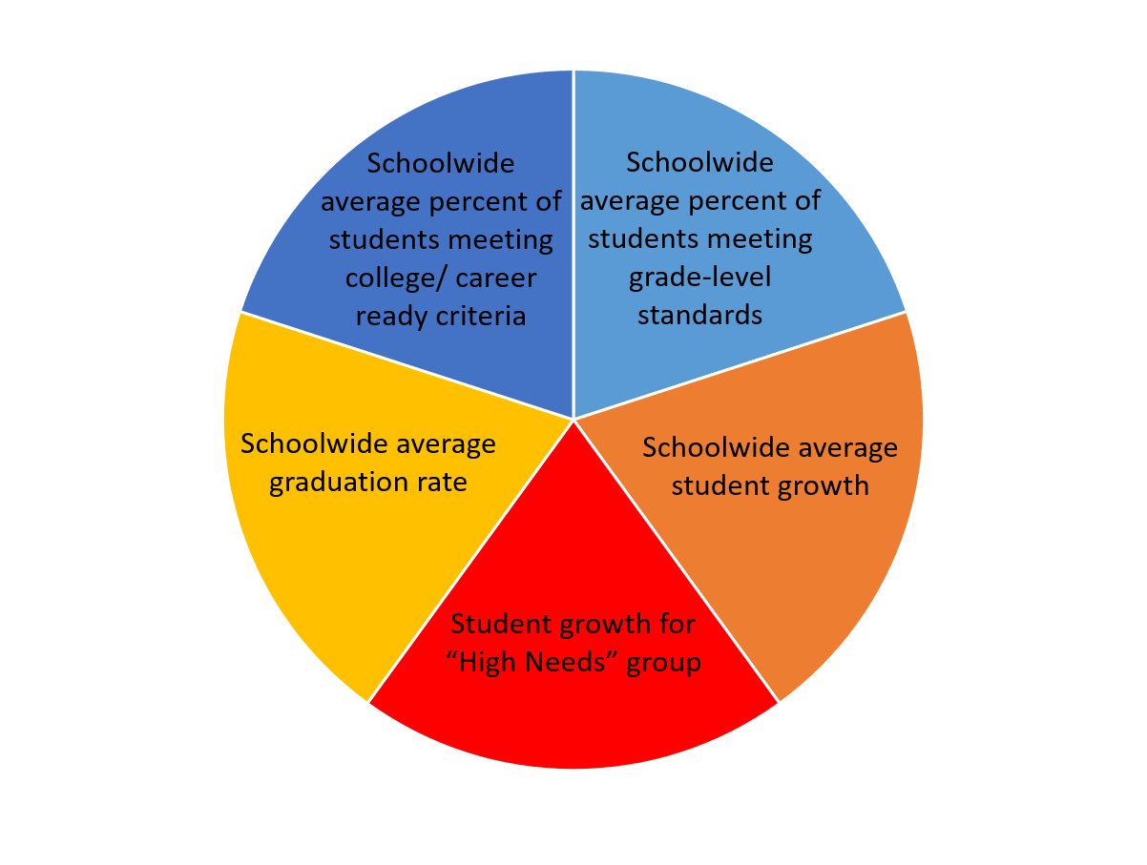
Two trends to note:
Results of individual groups of students don’t count at all. Instead of looking at individual groups of students, this system looks at a supergroup.
The only indicator for which anything other than “all student” results count is growth.

Slide 43
Supergroups: What are they? Why are they a problem?
“High needs” Supergroup
“Lowest performing” supergroup
What it is: A group that includes any student who falls into one or more historically underserved groups – e.g., any student who is low-income, an English learner or a student with a disability.
What’s the problem?
  Ignores meaningful distinctions between the needs of – and civil rights protections afforded to – each group.
  Allows one group’s results to mask those of another.
What it is: A group that includes the lowest-achieving students in each school – usually bottom 25 or 30 percent.
What’s the problem?
  Ignores higher-achieving students from historically underserved groups.
  Does not push schools to address systemic inequities in opportunity and achievement that often correlate with race, income, language proficiency and disability status.
Neither approach is a substitute for looking at results for individual groups of students

Slide 44
Failure to disaggregate all indicators: Why is that a problem?

Slide 45
By not counting results for individual groups of students, here’s what the state is doing:

Slide 46
If something is important enough to count for accountability, it’s important enough to count for every group of students the school serves.

Slide 47
Just measuring everything by student group isn’t enough. Results for all groups of students have to count in the school rating.

Slide 48
What many states chose to do in recent years
In recent years, many states justified their decision to assign ratings to schools based only on schoolwide averages by saying that they report results for individual groups of students, including whether schools met their goals for each group.
Did the school meet goals for…
All students?
Black students?
Latino students?
White students?
Asian students?
Native students?
Low income students?
English learners?
Students with disabilities?
1.
2.
A – F grade

Slide 49
Then, they’d report something like this:
School Grade
Goals Met/Not Met
A
All students - MET
White students - MET
African American students – NOT MET
Low Income students – NOT MET
Latino students - MET
Students with disabilities – NOT MET
Based on overall and supergroup results
Do you think anyone cared about this?

Slide 50
There are different ways to include group performance in school ratings, but the bottom line is this:
If a school is not meeting expectations for one or more groups of students, it should not be able to get a good rating.

Slide 51
2. Ratings must be based predominantly on student achievement and graduation rates.

Slide 52
States can and should include multiple measures (indicators) in their school ratings.
But rating criteria must make it clear that students’ academic success (including progress toward English-language proficiency for English learners) and graduation rates hold the most sway.

Slide 53

A school with continuously low achievement or graduation rates shouldn’t be excused from addressing that problem just because it has, for example, low chronic absenteeism rates.
On grade level in reading: 10%
On grade level in math: 12%
Percent ELs making progress toward English proficiency: 33%
Graduation rate: 68%
Chronic absenteeism rate: 1%
This school needs help

Slide 54
3. Rating criteria should set the same rigorous expectations for all groups of students

Slide 55
Rating criteria must make clear that all schools are required to reach the same performance expectations for all groups of students.

Slide 56
The state should set a single threshold for what “Excellent” means (e.g., a 95% graduation rate) -- or what “low-performing” means -- and apply that threshold to all schools and all groups.
You want to see this:
And NOT this:

Slide 57
Watch out for any attempts to compare results for a group of students with other schools’ results for the same group.
The state should not call a school “Excellent” because its graduation rates for low-income students are in the top 10 percent of low-income graduation rates in the state.
Similarly, a state should not call a school “low performing” for low-income students only if it is in the bottom 10 percent (or 20 percent, or 30) of low-income graduation rates.
Doing so creates vastly different performance expectations for different groups of students.

Slide 58
4. School ratings must take into account both performance and progress.

Slide 59
Consider two elementary schools: Cedar Street and Oakwood.
Cedar Street: Percent of students on grade level in reading
Oakwood: Percent of students on grade level in reading

Slide 60
In both, most students aren’t meeting grade-level standards in reading. But results at Cedar Street are clearly improving from year to year. Oakwood’s results are completely flat.
Cedar Street: Percent of students on grade level in reading
Oakwood: Percent of students on grade level in reading

Slide 61
School rating criteria should give Cedar Street credit for the improvement it is making.

Slide 62


Importantly, not all improvement is the same.
Percent of students meeting grade level standards in reading
Consider Maple Lane Elementary. Like Cedar Street, it is improving – but very, very slowly. In fact, if Maple Lane keeps improving at its current rate, it’ll take 20 years before half of its students meet grade-level standards.
Cedar Street
Maple Lane

Slide 63
While Cedar Street certainly should get credit for the gains it is making, Maple Lane clearly should not.
But how much improvement is enough?

Slide 64
This is why states need to set ambitious and attainable goals for improving student outcomes
Goals communicate where the state wants all schools to get to in the near future for all groups of students.
Instead of arbitrarily deciding how much improvement is enough, the state can then look at whether or not schools are on track to meet the state’s goal.

Slide 65
5. Rating criteria – and the ratings themselves – must be understandable and transparent.

Slide 66
Rating criteria are a powerful tool for communicating expectations.
But they can only serve this function if educators – as well as parents, community members, and the public – can understand what is expected of them.

Slide 67

Right now, some states’ rating criteria make it nearly impossible to figure that out.

Slide 68
Some rank schools every year – so a school’s rating is based entirely on how it compares to other schools.
Some include measures that are very hard to understand.
Others include lots of statistical manipulations that make it impossible to predict what a school needs to do to get a particular rating.

Slide 69
Some complexity is unavoidable. But avoidable complexity should be avoided.
General rule 1:
If you can’t understand the rating criteria, and the state can’t explain them to you, there’s a problem
General rule 2:
A school should be able to know at the beginning of the school year what it needs to do to get a particular rating.

Slide 70


That goes for the ratings themselves, too.
Needs Improvement
330 out of 800

Slide 71
What’s next?

Slide 72
Because most states’ rating systems are not in compliance with ESSA, nearly all will have to make changes to their ratings.
After lunch, we have three working sessions for you to choose from, depending on the current climate in your state.

Slide 73
Three options for working sessions
If your state is having a fight about whether it’s important to have ratings at all…
Stay in this room for a session with Kati Haycock to learn more about this debate and strategies for finding a middle ground.
If you think your state will try to make as few changes as possible to its current school ratings…
Go to Texas I-II for a session with Daria Hall on questions to ask about these existing systems and ideas for things to push on
If you think your state will be making substantial changes to its system…
Go to Paluxy I-III for a session with Natasha Ushomirsky about decisions states will have to make, what to look for, and what to push on

