Slide 1
College Student Development Theory
Bob Obrohta
Executive Director – TN College Access and Success Network

Slide 2
Human Development Domains The development of a human throughout their lifespan
Physical development involves growth and changes in the body and brain, the senses, motor skills, and health and wellness.
Cognitive development involves learning, attention, memory, language, thinking, reasoning, and creativity.
Psychosocial development involves emotions, personality, and social relationships.
Identity sub-domain examples: Gender Identity, Racial Identity, Cultural Identity, College Student Development, Career Development
Notes:
Talk about Crisis and Tasks

Slide 3
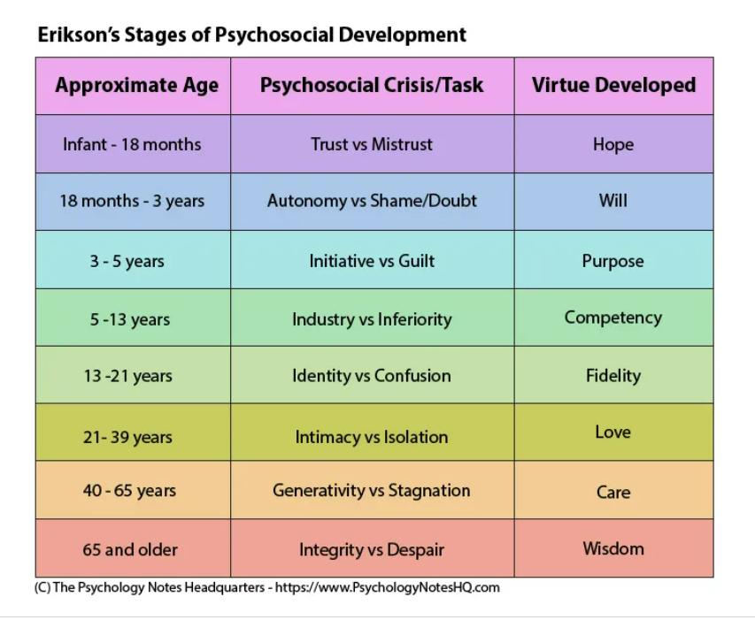
Eric Erikson
Notes:
Youth vs Adult

Slide 4
Identity vs Confusion (Lloyd Dobbler – Say Anything)

Slide 5
The Human Development Approach Student Centered
Expanding the richness of human life, rather than simply the richness of the economy in which human beings live. It is an approach that is focused on creating fair opportunities and choices for all people.
William Perry: Cognitive Theory – 4 “Stages” Intellectual and Ethical Development
Arthur Chickering: Psychosocial Theory – 7 “Vectors” of Identity Development
Notes:
Talk about vectors vs stages

Slide 6
Perry’s 4 Stages of Cognitive Development
3
4.)
Dualism – every problem is solvable. Things are “black or white.” There are right answers and learn to obey authority.
2
1
Multiplicity – there are two types of problems: a) solvable, b) problems that the answer is not known yet. Students put trust in their “inner voice.”
Relativism – all solutions to problems must have reasons and be viewed in a specific context. Every issue must be evaluated within its context.
Commitment – acceptance of uncertainty is a part of life. Personal experiences + outside sources = conclusion.

Slide 7
Chickering’s 7 Vectors of College Student Identity
Developing and maintaining interpersonal relationships.
Establishing a personal identity.
Developing a personal purpose.
Understanding the definition of integrity.
Learning to manage emotions.
Developing competence.
Transitioning from autonomy to inter-dependence.
Notes:
Don’t forget to discuss adults

Slide 8
Chickering Vectors 1&2
Developing Competence
Managing Emotions
Social competence
Physical competence
Intellectual competence
Understanding and Accepting emotions
Expressing them in an appropriate fashion
Emotionally independent – no longer needing constant affirmation, comfort, or approval
Using appropriate channels as opposed to exploding.

Slide 9
Chickering Vectors 3&4
Autonomy/Interdependence
Interpersonal Relationships
Parental/guardian - reliance/separation/reliance
Seeing the “big picture” connections
No one is an island
Understanding and appreciating people for who they are and their differences
Ethnic and cultural tolerance
Developing and maintaining long-term personal relationships

Slide 10
Vector 5: Establishing a Personal Identity
Becoming comfortable with oneself
Personal appearance
Sexual Identity
Gender Identity
Religion
Social Roles
Ethnicity
Self-esteem
Emotionally stable

Slide 11
Chickering Vectors 6&7
Developing Purpose
Developing Integrity
Creating goals
Refining skills to develop niche expertise
Preferred vocation
Early reliance on family and friends for advice but over time, pursues their own path.
Values are humanized, personalized, and promoted
Doing the right thing when no one is watching
Core personal values
Respecting others beliefs and opinions

Slide 12
Intentionality
Mentoring/Counseling
Programmatic Design
Summer Programs
Creating environments where development floursishes

