Slide 1

Federal Stimulus Funds: 5 Principles
Jessica Swanson
5/24/2021
©2021 Edunomics Lab, Georgetown University

Slide 2
Reminder: LEAs have until 2024 to obligate newest federal funds
$123B ARP ESSER III. LEAs must obligate by 9/2024 ~ $2400 per pupil
20% must be used for learning loss.
$54B CRSSA ESSER II. SEAs must obligate by 9/2023 ~ $1,100pp
Broadly flexible. DoED: expenses must relate to COVID.
$13B CARES ESSER I. LEAs must obligate by 9/2022 ~$250pp
SY 19-20
SY 20-21
SY 21-22
SY 22-23
SY 23-24
SY 24-25
School & Calendar Year
Calendar 2020
2021
2022
2023
2024
Apr
Jul
Oct
Jan
Apr
Jul
Oct
Jan
Apr
Jul
Oct
Jan
Apr
Jul
Oct
Jan
Apr
Jul
Oct
Jan
Mar
©2018Edunomics Lab, Georgetown University
©2021 Edunomics Lab, Georgetown University

Slide 3
Poll
Which of the following is not an allowable use of ESSER funds for LEAs?
Enlarge the gym
Reinstate a 5% pay raise that was put on hold
Pay the Kumon fee for any student who opts in
Pay for staff positions that would otherwise be cut due to enrollment declines
Replenish the reserve fund
Use ESSER funds to supply COVID-19 tests at school sites
This money is highly flexible. Districts are the ones who decide how to spend it!
X
©2021 Edunomics Lab, Georgetown University

Slide 4
ARP funding for schools: Five principles to guide district spending decisions
Commit to a multi-year spending plan
  Avoid adding new recurring costs to avert disruptive fiscal cliff.
  Maintain a long term financial forecast.
Seek targeted investments to increase learning time for students who need it most
Honor the promise to taxpayers to focus on students and relief
  Compute the per-student costs or cost per extra student hour, to ensure spending is reasonable.
  Find ways to measure effects on students and ensure success.
  Be nimble and adjust plans as needed
Be transparent and ensure broad participation in spending decisions
  Engage parents, communities and especially boards on spending choices.
  Have principals gauge whether investments match need of their students with feasibility for success.
  Apply proper procurement protocols. Publicly share all investments, providers and intended benefits.
Consider how equitably funds are applied across schools
  Compute $/student impacts on each school.
©2018Edunomics Lab, Georgetown University
©2021 Edunomics Lab, Georgetown University

Slide 5
Will we have a funding cliff?
Leaders will want to pace themselves and plan ahead for when federal aid ends.
Federal $ enables districts to maintain cost structure, but eventually runs out
Funding cliffs are typical when federal relief aid stops
K-12 Revenue trend
Fed $ fills gaps
State Revenues
COVID-impacted K-12
2020
2021
2022
2023
2024
Furloughs/ layoffs, stagnant pay
COVID HITS!
©2018Edunomics Lab, Georgetown University
©2021 Edunomics Lab, Georgetown University
©2021 Edunomics Lab, Georgetown University

Slide 6

Tricky balance:
Make a plan for spending down the funds.
VS
How about…?
40% SY21-22
30% SY22-23
20% SY23-24
10% SY24-25
Spend NOW
to address learning loss
PACE spending to avert a fiscal cliff
©2018Edunomics Lab, Georgetown University
©2021 Edunomics Lab, Georgetown University

Slide 7
ARP funding for schools: Five principles to guide district spending decisions
Commit to a multi-year spending plan
  Avoid adding new recurring costs to avert disruptive fiscal cliff.
  Maintain a long term financial forecast.
Seek targeted investments to increase learning time for students who need it most
Honor the promise to taxpayers to focus on students and relief
  Compute the per-student costs or cost per extra student hour, to ensure spending is reasonable.
  Find ways to measure effects on students and ensure success.
  Be nimble and adjust plans as needed
Be transparent and ensure broad participation in spending decisions
  Engage parents, communities and especially boards on spending choices.
  Have principals gauge whether investments match need of their students with feasibility for success.
  Apply proper procurement protocols. Publicly share all investments, providers and intended benefits.
Consider how equitably funds are applied across schools
  Compute $/student impacts on each school.
©2018Edunomics Lab, Georgetown University
©2021 Edunomics Lab, Georgetown University

Slide 8
Beware of adding recurring costs!
Instead of recurring expenses:
Consider one-time expenses:
New hires (e.g. nurses, counselors, VP, teachers, tutors)
Base pay raises: Across-the-board % raises, COLAs
Increased benefits
Permanent calendar changes
Changes to class sizes
Stipends (e.g. for tutoring, summer school
Contractors (e.g. nurses, tutors)
One-time hazard pay
Facility upgrades
One-time summer school
Temporarily added weeks of school
©2018Edunomics Lab, Georgetown University
©2021 Edunomics Lab, Georgetown University

Slide 9
ARP funding for schools: Five principles to guide district spending decisions
Commit to a multi-year spending plan
  Avoid adding new recurring costs to avert disruptive fiscal cliff.
  Maintain a long term financial forecast.
Seek targeted investments to increase learning time for students who need it most
Honor the promise to taxpayers to focus on students and relief
  Compute the per-student costs or cost per extra student hour, to ensure spending is reasonable.
  Find ways to measure effects on students and ensure success.
  Be nimble and adjust plans as needed
Be transparent and ensure broad participation in spending decisions
  Engage parents, communities and especially boards on spending choices.
  Have principals gauge whether investments match need of their students with feasibility for success.
  Apply proper procurement protocols. Publicly share all investments, providers and intended benefits.
Consider how equitably funds are applied across schools
  Compute $/student impacts on each school.
©2018Edunomics Lab, Georgetown University
©2021 Edunomics Lab, Georgetown University

Slide 10
Compute per pupil costs to explore cost and value of investments
 | Total cost | Target students | # students | Cost/student | Per student cost per hour
CT Summer program | $11M | All ages | 24,000 | $458/student
Atlanta Summer Program | $13M | All ages, priority for struggling students | 20,000 | $650/student
Boston K-1 Summer Enrichment | $1.7M | K-1 | 500 | $3,400/student | $24/hour pp
Boston's Extended sch year | $7M | Students with IEPs | 3,322 | $2,107/student | $84/hour pp
Example – 5 days/week 1:1 tutoring |  |  |  | $7,200/student | $40/hour pp
Example – 3 days/week 1:4 tutoring |  |  | x4 | $1,080/student | $10/hour pp
©2018Edunomics Lab, Georgetown University
©2021 Edunomics Lab, Georgetown University

Slide 11
ARP funding for schools: Five principles to guide district spending decisions
Commit to a multi-year spending plan
  Avoid adding new recurring costs to avert disruptive fiscal cliff.
  Maintain a long term financial forecast.
Seek targeted investments to increase learning time for students who need it most
Honor the promise to taxpayers to focus on students and relief
  Compute the per-student costs or cost per extra student hour, to ensure spending is reasonable.
  Find ways to measure effects on students and ensure success.
  Be nimble and adjust plans as needed
Be transparent and ensure broad participation in spending decisions
  Engage parents, communities and especially boards on spending choices.
  Have principals gauge whether investments match need of their students with feasibility for success.
  Apply proper procurement protocols. Publicly share all investments, providers and intended benefits.
Consider how equitably funds are applied across schools
  Compute $/student impacts on each school.
©2018Edunomics Lab, Georgetown University
©2021 Edunomics Lab, Georgetown University

Slide 12
ARP funding for schools: Five principles to guide district spending decisions
Commit to a multi-year spending plan
  Avoid adding new recurring costs to avert disruptive fiscal cliff.
  Maintain a long term financial forecast.
Seek targeted investments to increase learning time for students who need it most
Honor the promise to taxpayers to focus on students and relief
  Compute the per-student costs or cost per extra student hour, to ensure spending is reasonable.
  Find ways to measure effects on students and ensure success.
  Be nimble and adjust plans as needed
Be transparent and ensure broad participation in spending decisions
  Engage parents, communities and especially boards on spending choices.
  Have principals gauge whether investments match need of their students with feasibility for success.
  Apply proper procurement protocols. Publicly share all investments, providers and intended benefits.
Consider how equitably funds are applied across schools
  Compute $/student impacts on each school.
©2018Edunomics Lab, Georgetown University
©2021 Edunomics Lab, Georgetown University

Slide 13
Poll
If a district is adding learning time by paying current staff, how should they pay them?
Fixed dollar amount (e.g., $35 per hour per teacher or $1300 for starting school 2 weeks early)
Use of current salaries (e.g., each teacher’s hourly rate based on individual salaries)
Other – tell us in the chat
Using current salaries could exacerbate current inequities across schools.
©2021 Edunomics Lab, Georgetown University

Slide 14

ESSA requires the reporting of spending by school!
Download the data and check back for future updates:
www.edunomicslab.org/nerds
©2021 Edunomics Lab, Georgetown University

Slide 15
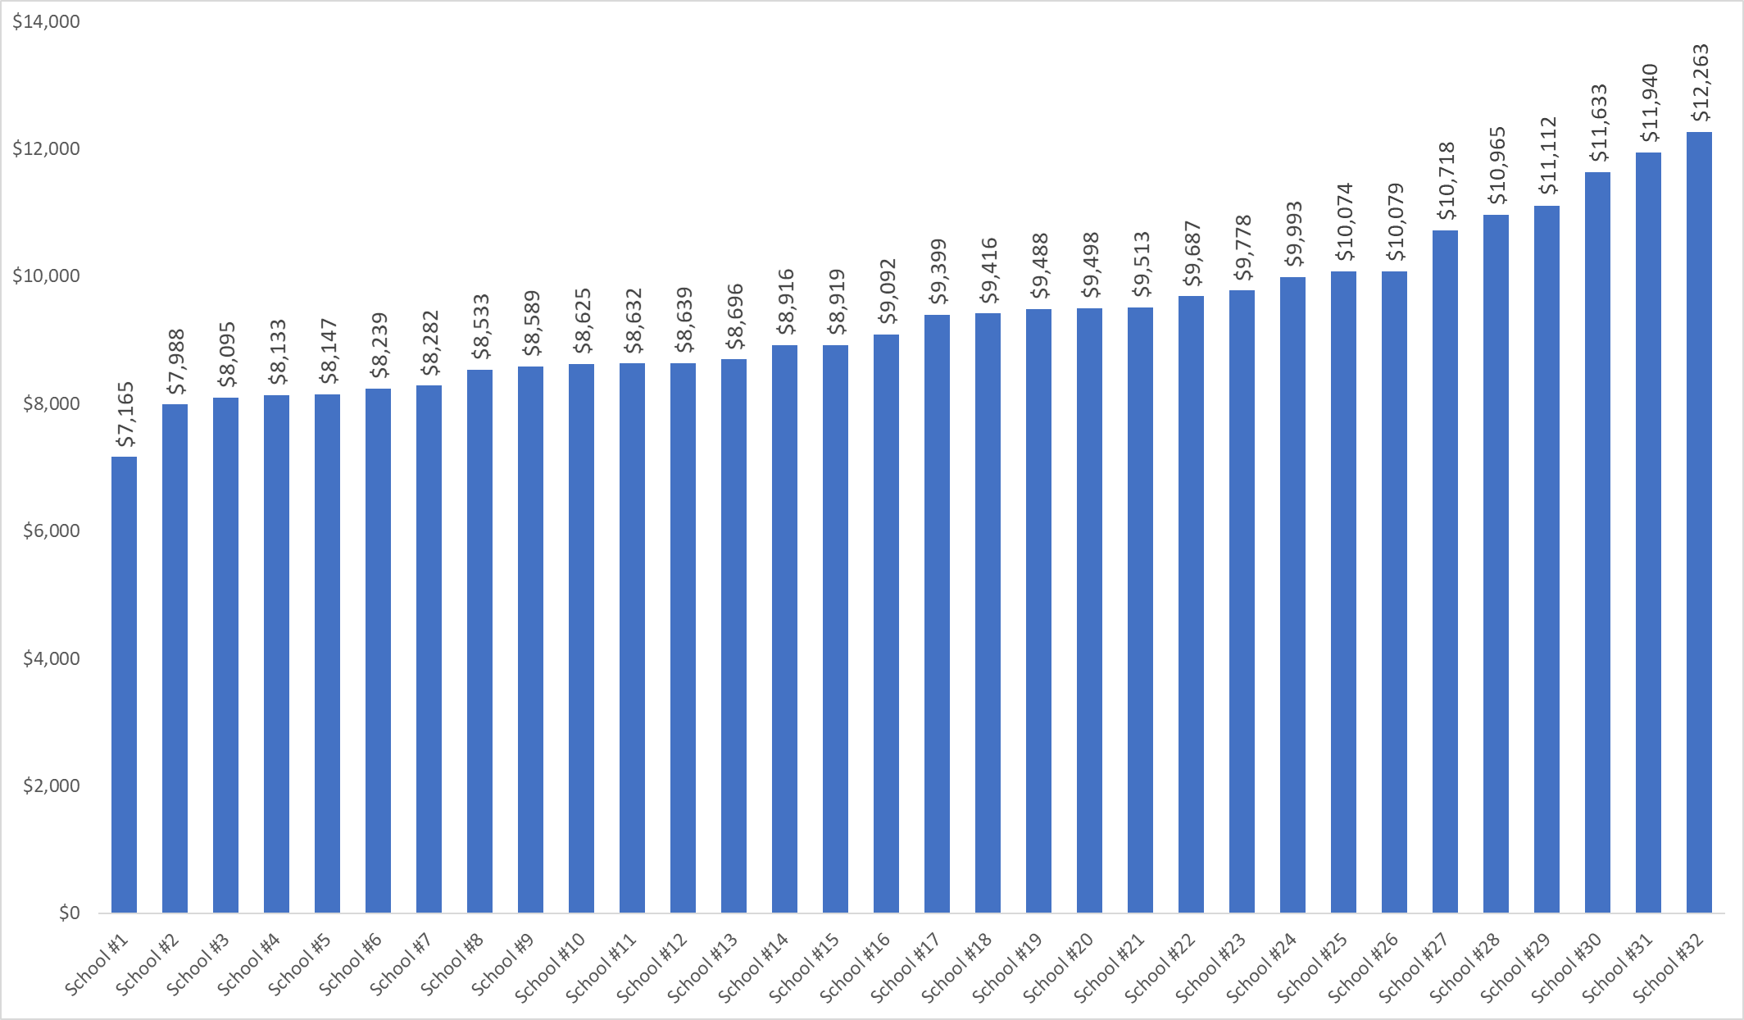

Slide 16
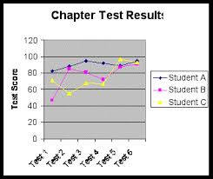

New data enables comparisons of spending with student outcomes, by school
Outcomes by school
Spending by school
+
©2021 Edunomics Lab, Georgetown University
©2019 Edunomics Lab, Georgetown University

Slide 17
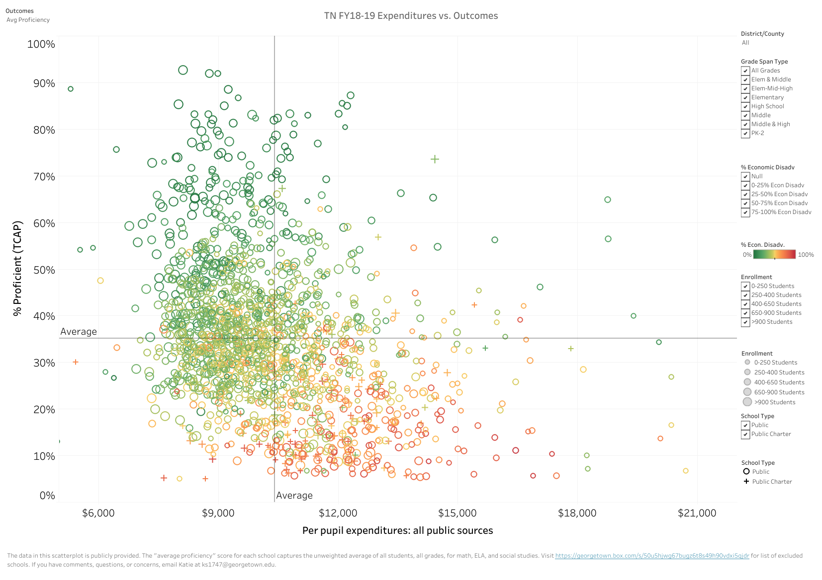

Spending vs. Outcomes All Schools in TN (2018-19)
https://edunomicslab.org/tennessee/
©2021 Edunomics Lab, Georgetown University
©2019 Edunomics Lab, Georgetown University

Slide 18
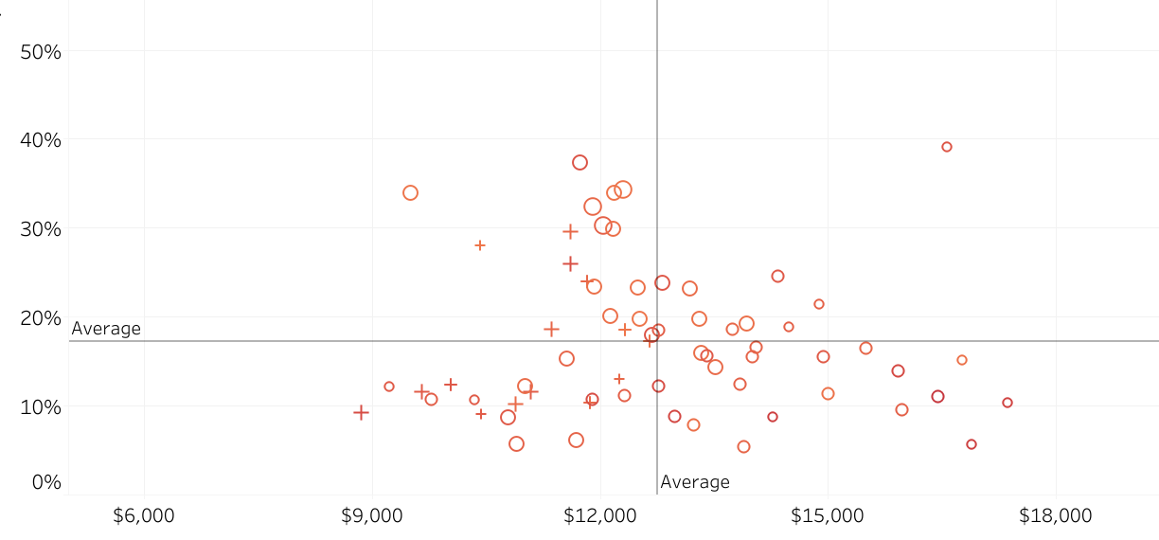
Spending vs. outcomes filtered for similar schools in TN:
Elementary schools >75% FRL
II. Lower spending, higher outcomes
I. Higher spending, higher outcomes
A
School C is better able to use limited dollars to do more for students.
C
School A has stronger student outcomes, but uses more public dollars.
School B is also receiving more dollars than peers but hasn’t been able to translate these funds into results.
School D receives fewer dollars than peers and has low student outcomes.
D
B
III. Lower spending, lower outcomes
IV. Higher spending, lower outcomes
https://public.tableau.com/profile/edunomicslab#!/vizhome/TennesseeFY18-19/TNDashboard
©2021 Edunomics Lab, Georgetown University
©2019 Edunomics Lab, Georgetown University

Slide 19


Questions
Visit EdunomicsLab.org for resources.
Jessica Swanson
Jessica.Swanson@Georgetown.edu and @thejswan
©2018Edunomics Lab, Georgetown University
©2021 Edunomics Lab, Georgetown University

